Slide 1

Art, Media & Photography
Please click on the speaker icons for audio descriptions

Slide 2

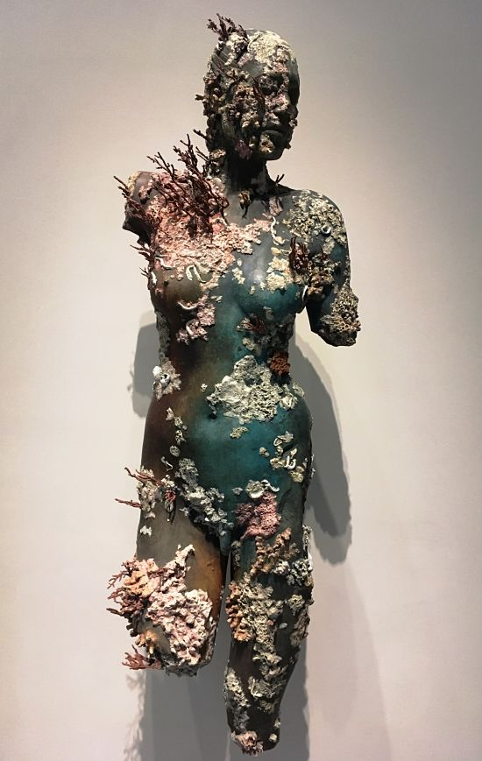
Why choose Art?
You enjoy being expressive with paint or sculpture
You are interested in a creative career when you’re older
You want a subject that is less stressful than some others
You want to learn about Modern Art and how it affects our culture

Slide 3
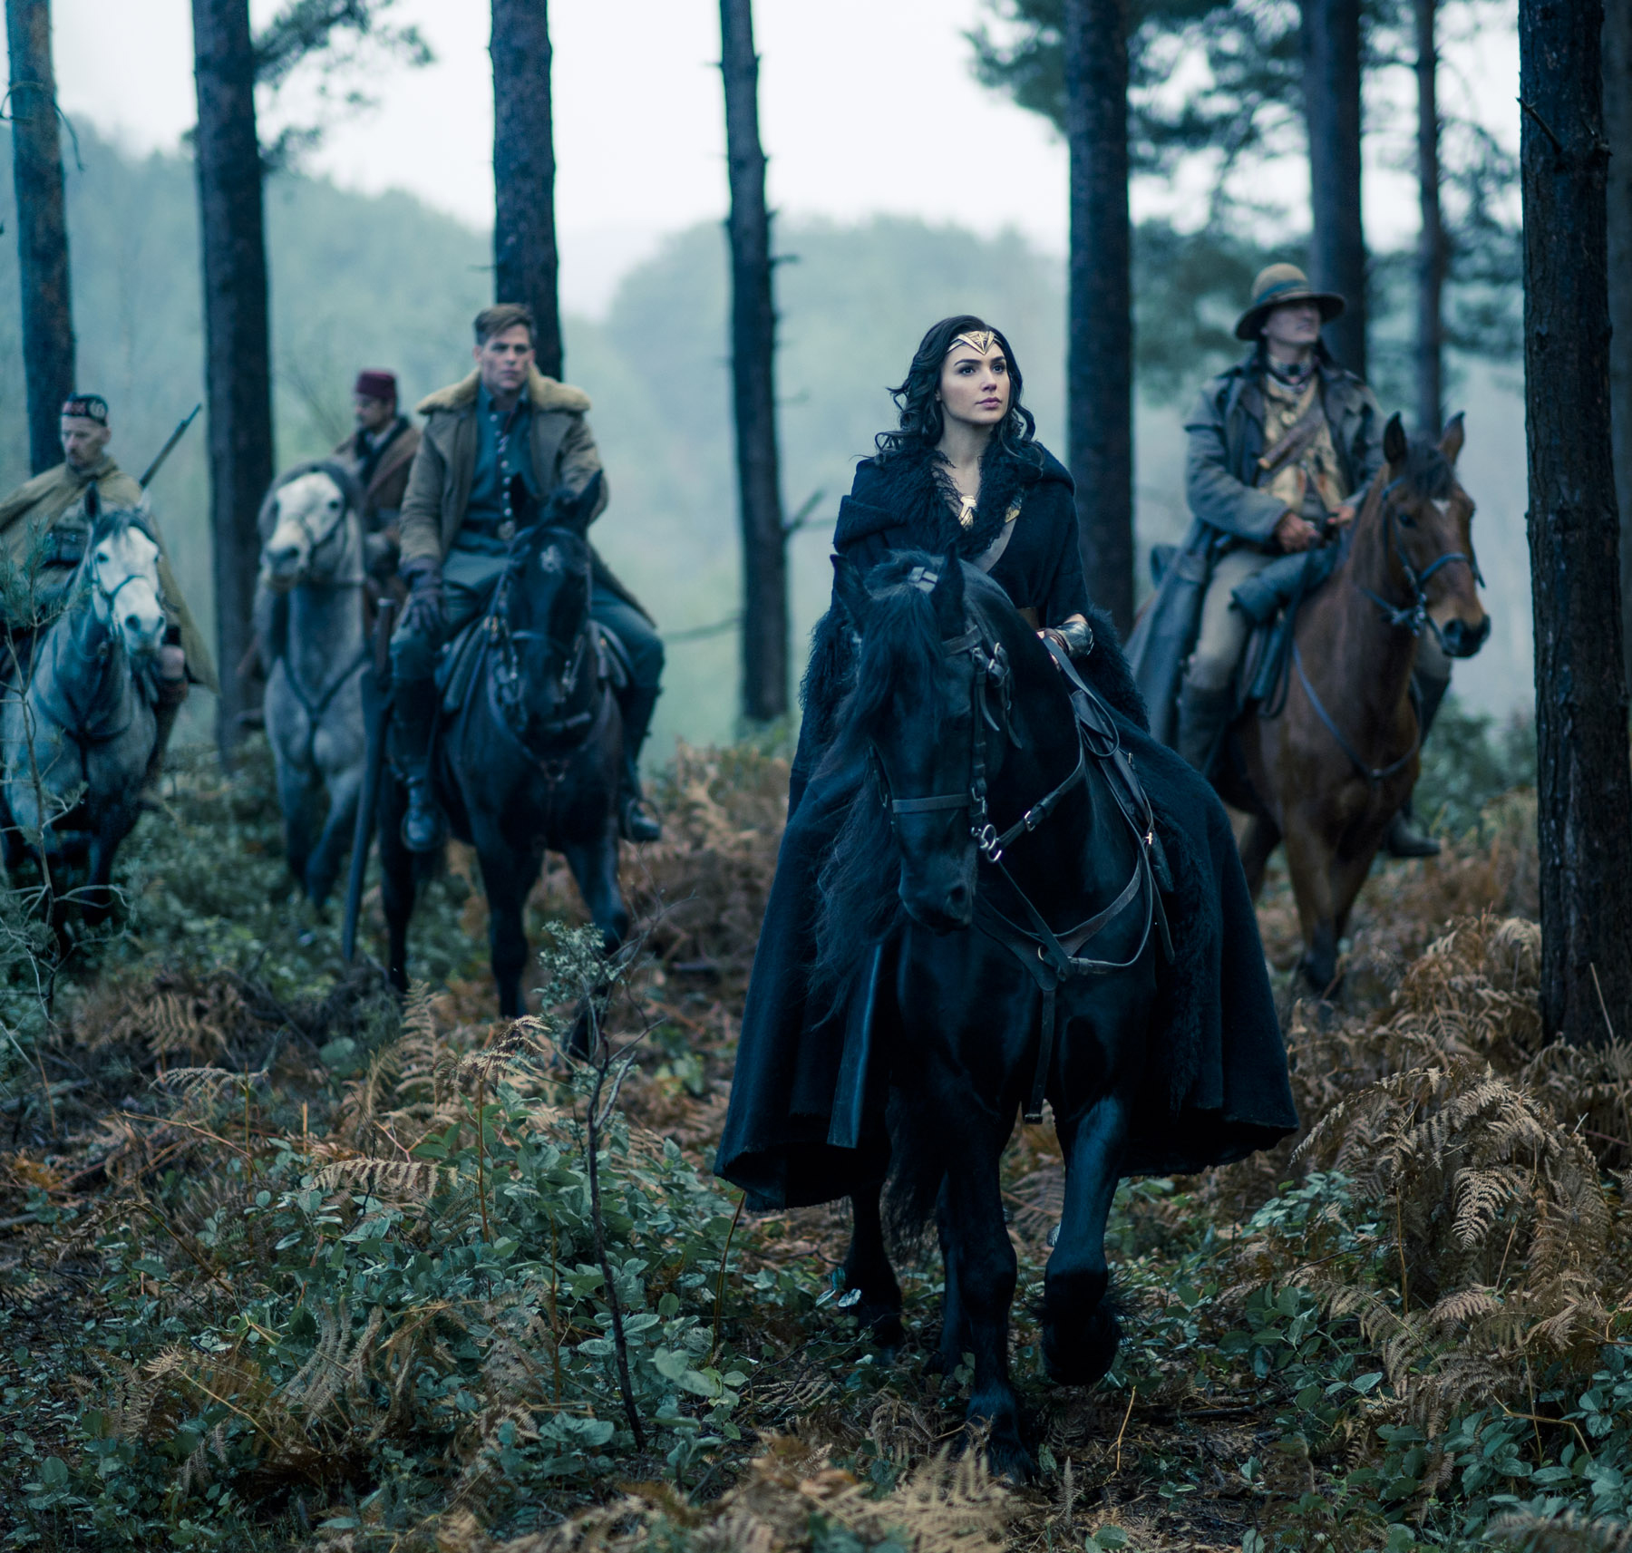
Why choose Media?
You’re a fan of film, TV and Gaming
You want to develop a technical knowledge of film techniques
You like working with others & being organised
You have an interest in design & illustration

Slide 4
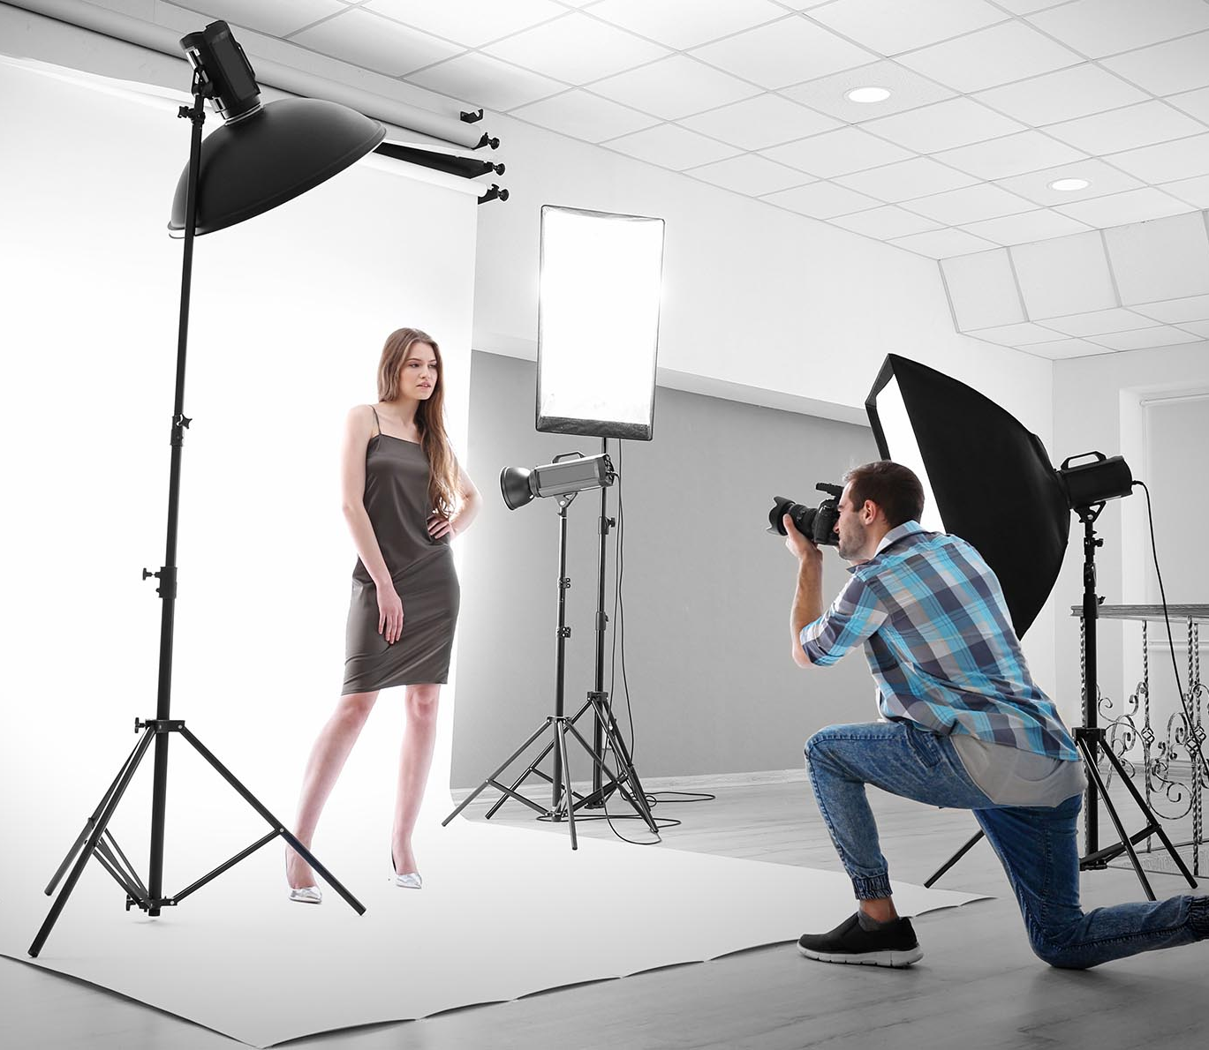
Why choose Photography?
You like to capture events and moments in time with a camera
You are keen to build up your confidence when taking photos
You show imagination & creativity using computer software
You are inquisitive and curious about the world around you

Slide 5

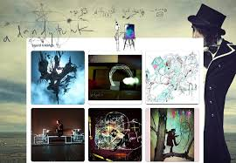
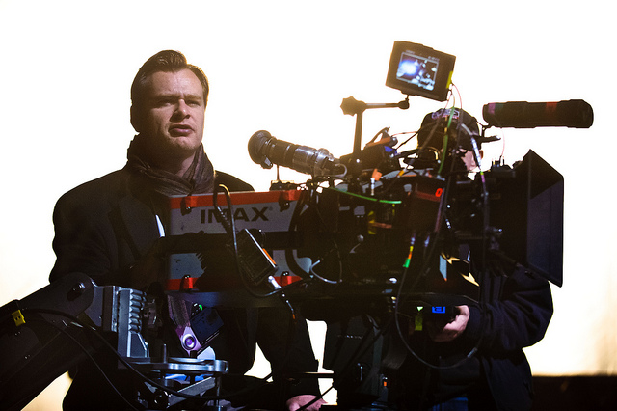
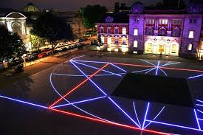
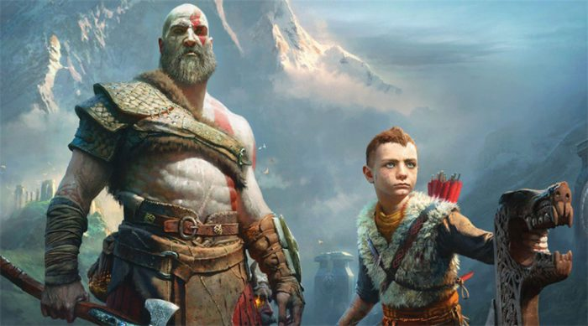

Where could it lead?
Art schools and colleges
Creative Hobbies
Careers in Visual Arts

