Slide 1

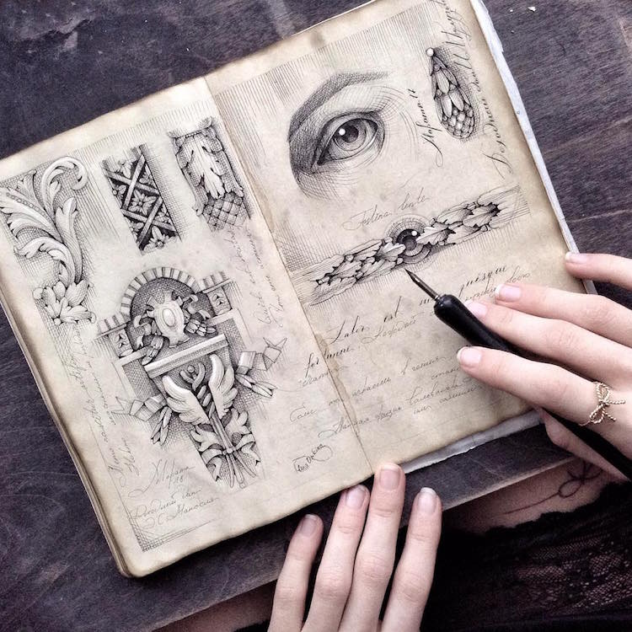

Sketchbook Support
Visual Art More House
www.visualartmh.com

Slide 2
About this guide.
This visual guide is designed to be a simple resource that describes the most obvious pages needed in an Art sketchbook.
This is not a definitive list and may vary from student to student.
It is designed mainly for BTEC level 2 and 3 students.
Each image is roughly in the suggested order, but again this may vary.

Slide 3
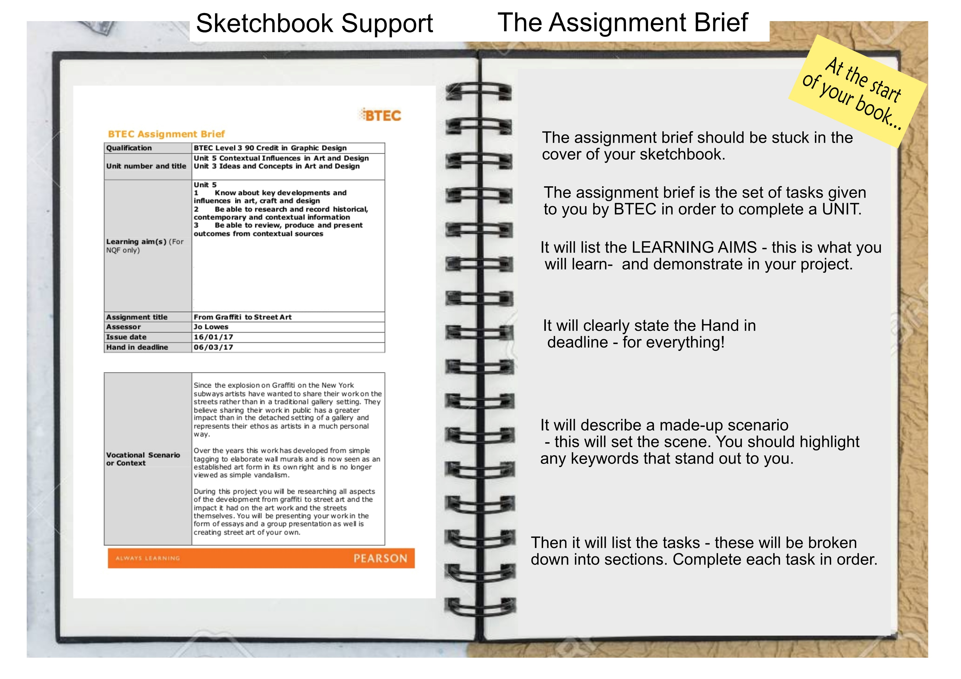

Slide 4
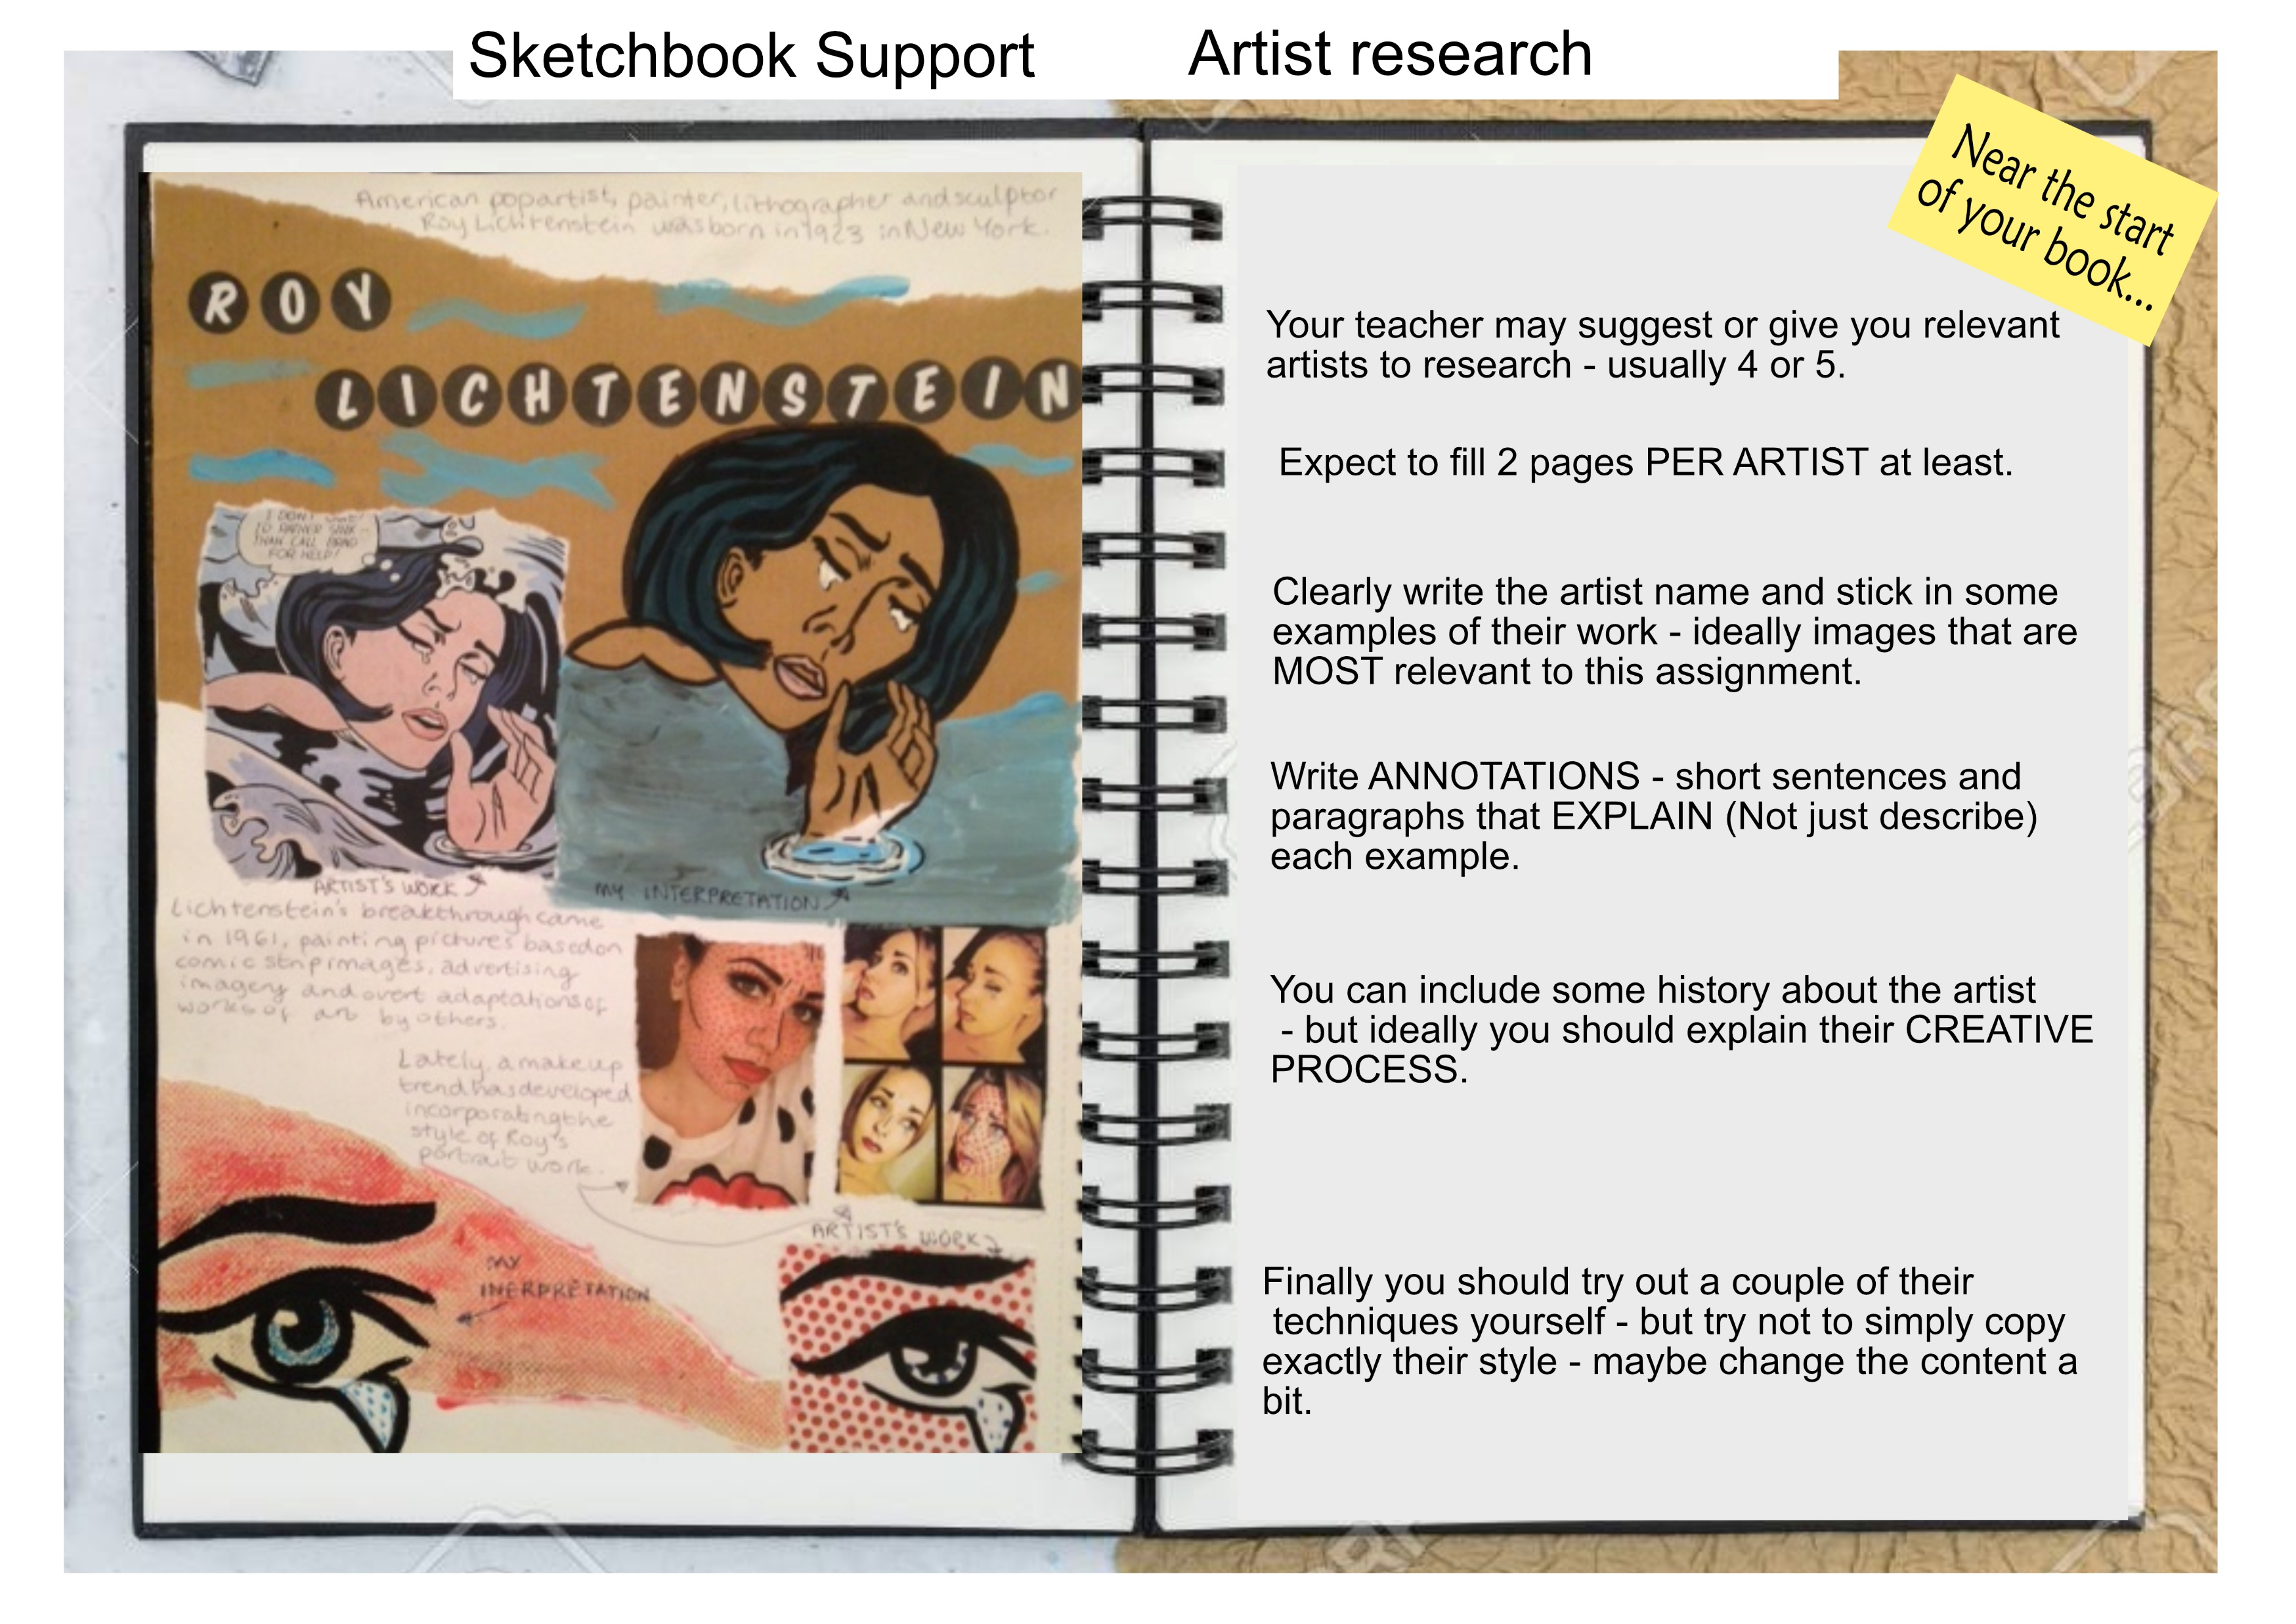

Slide 5
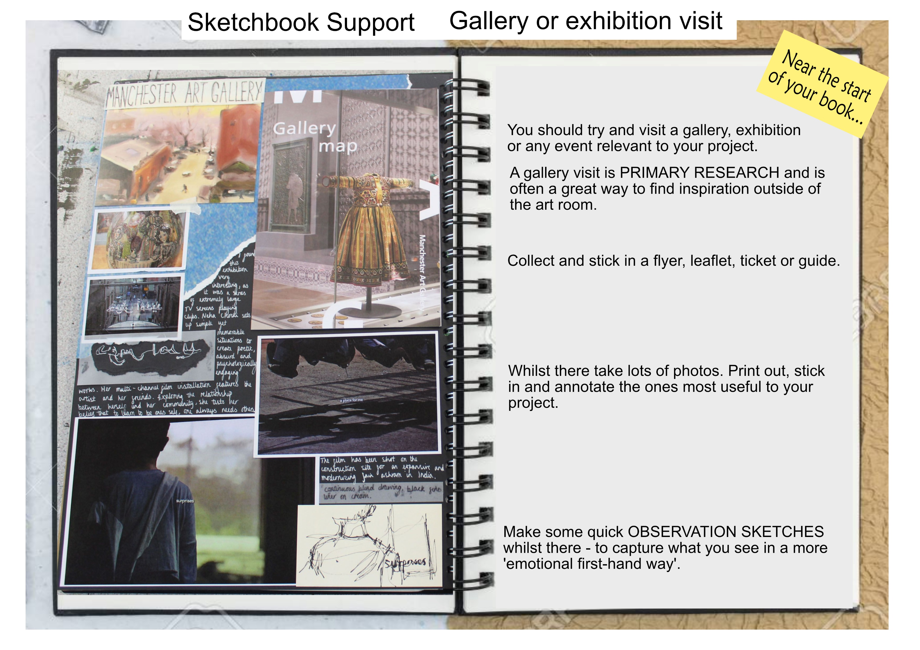

Slide 6
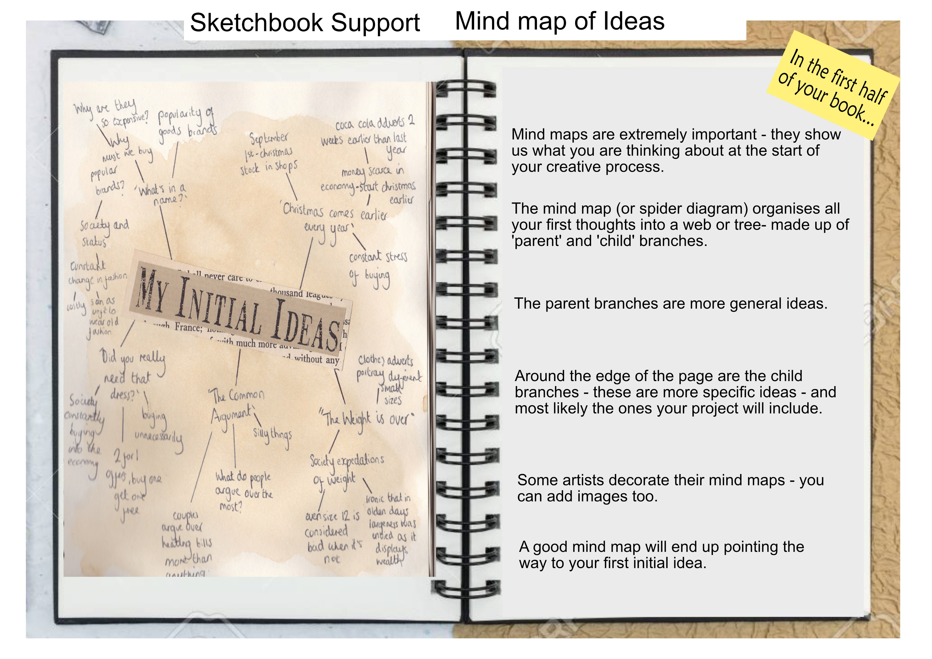

Slide 7
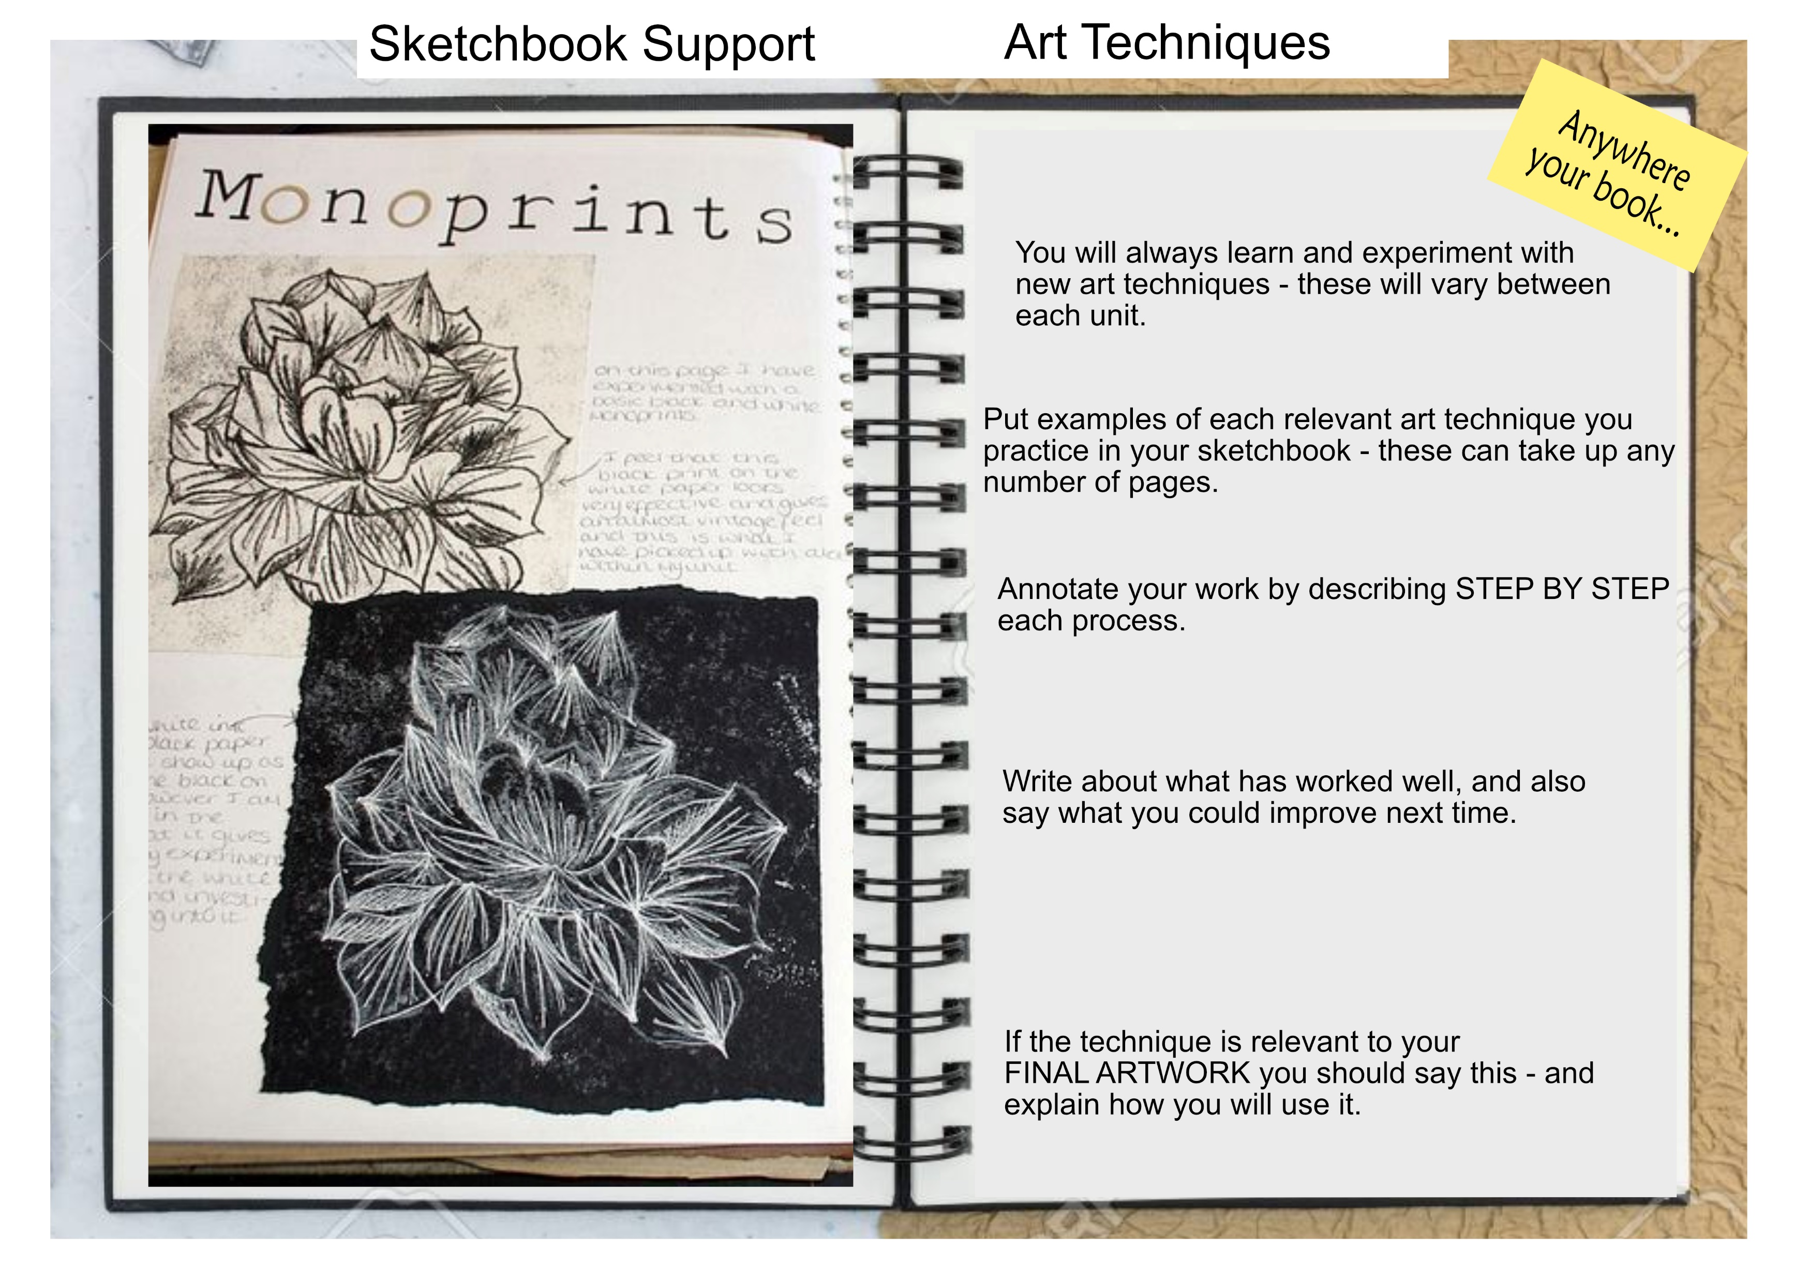

Slide 8
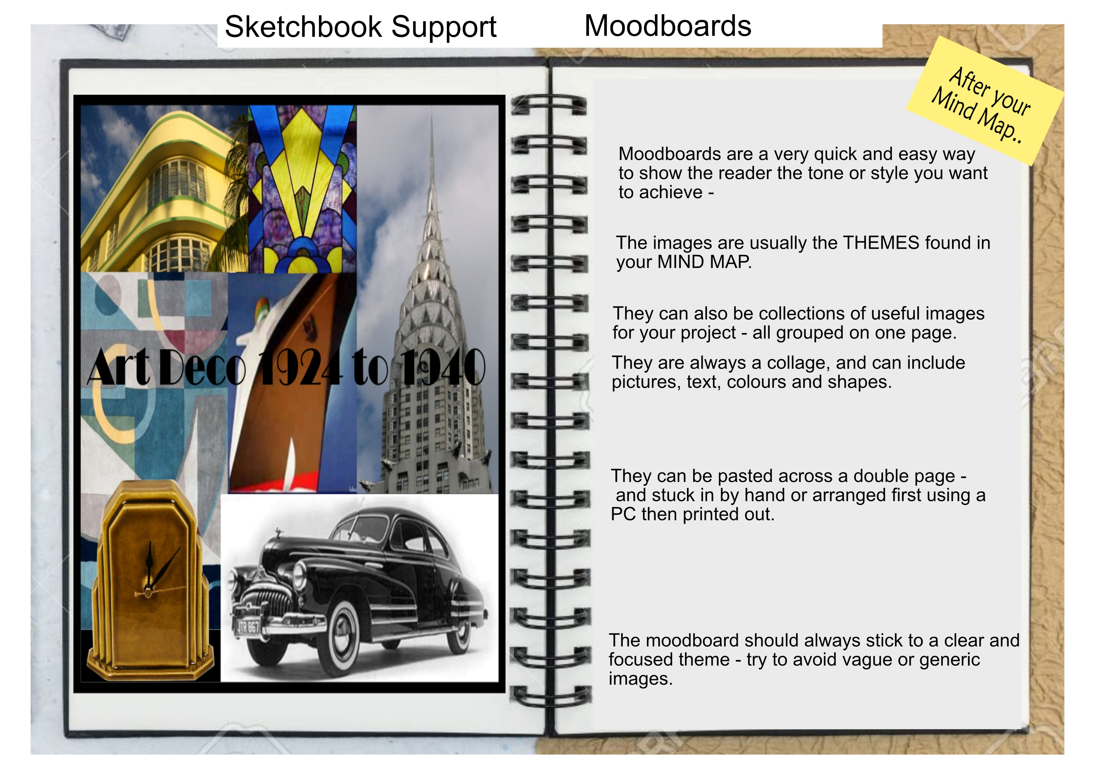

Slide 9
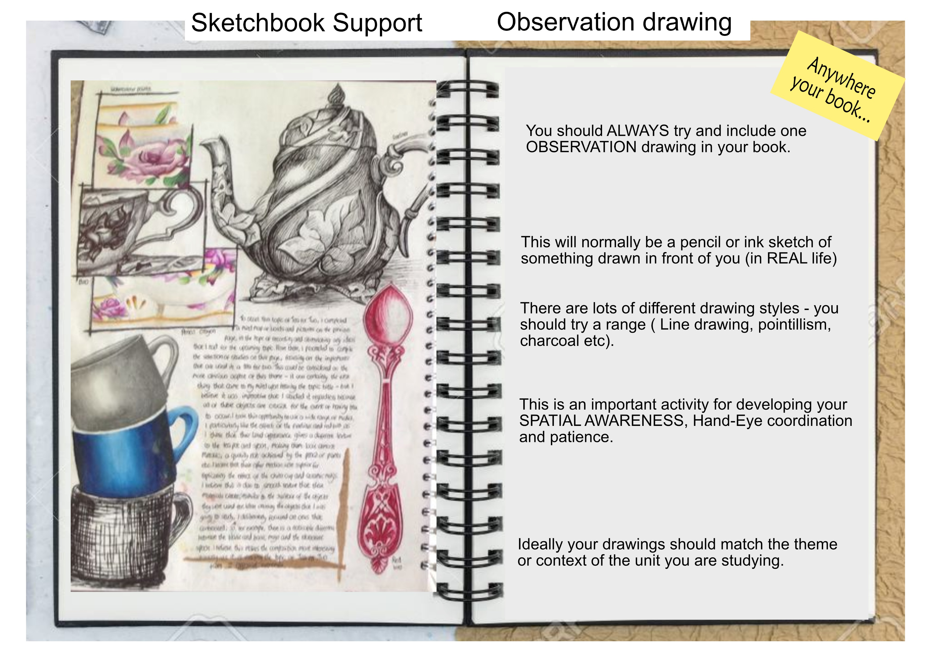

Slide 10
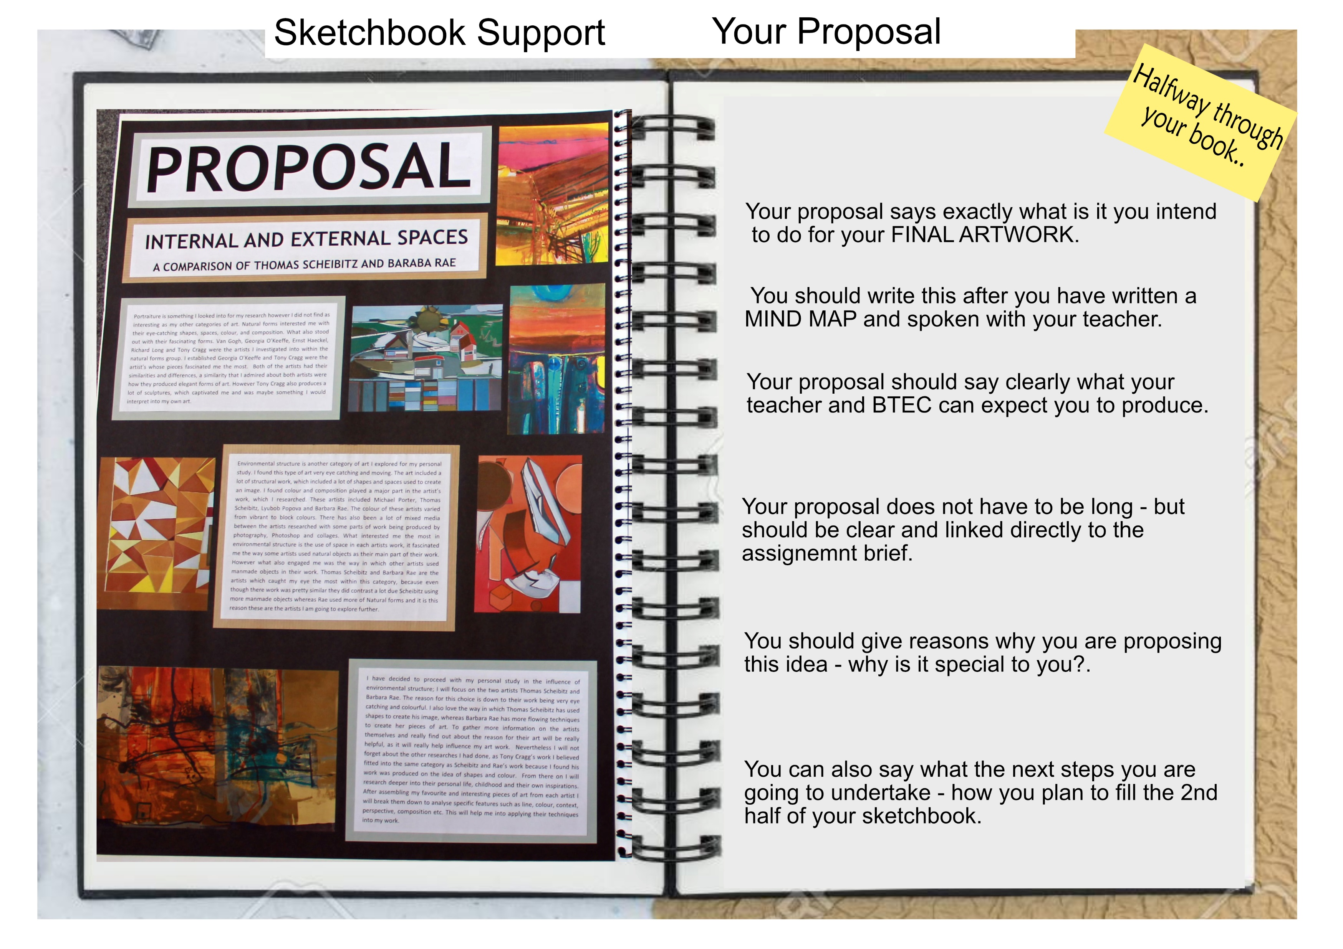

Slide 11
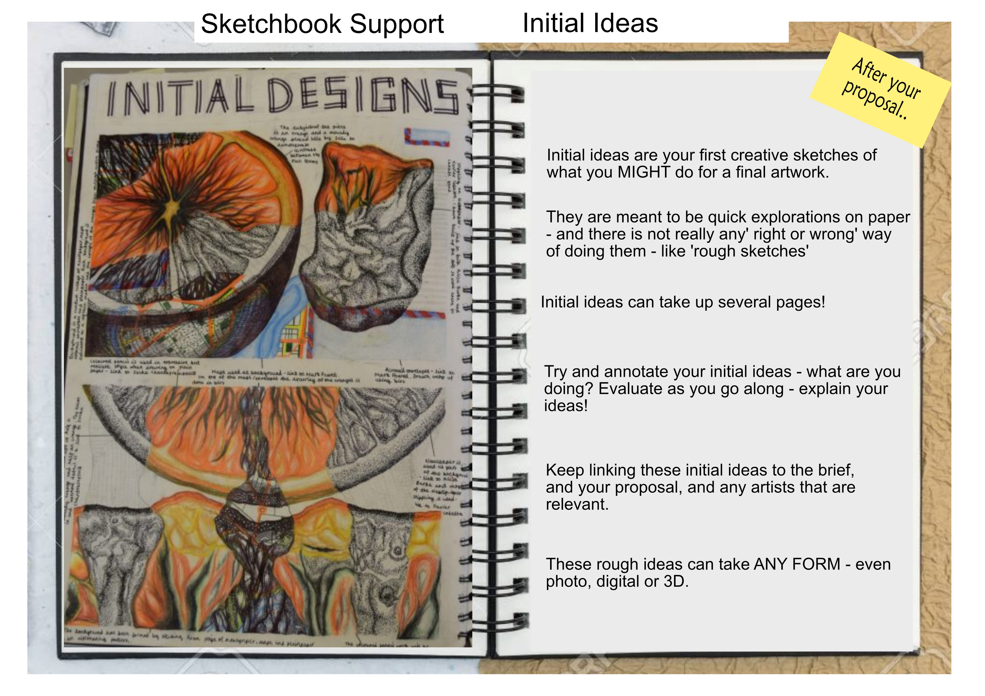

Slide 12
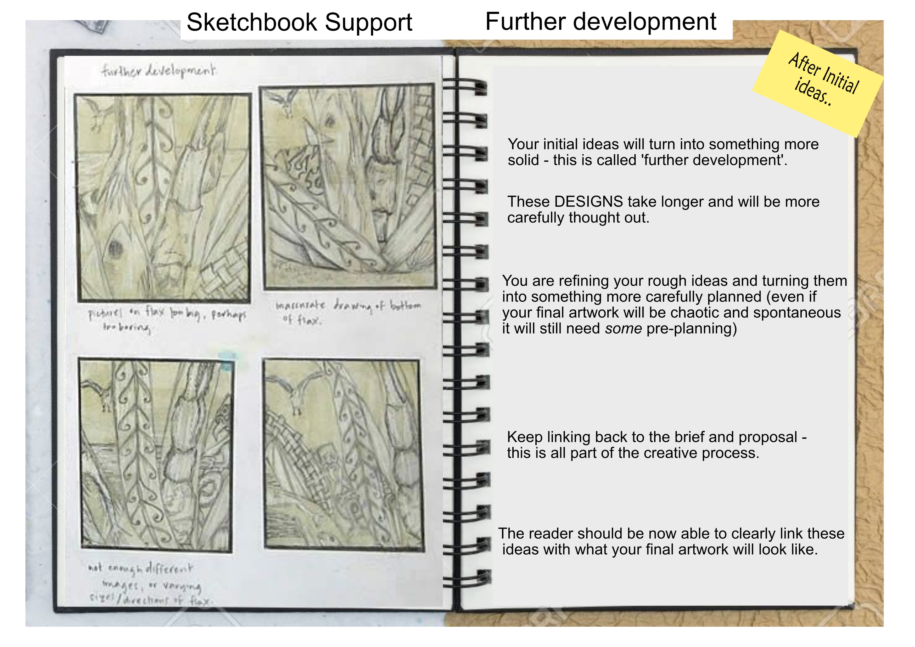

Slide 13
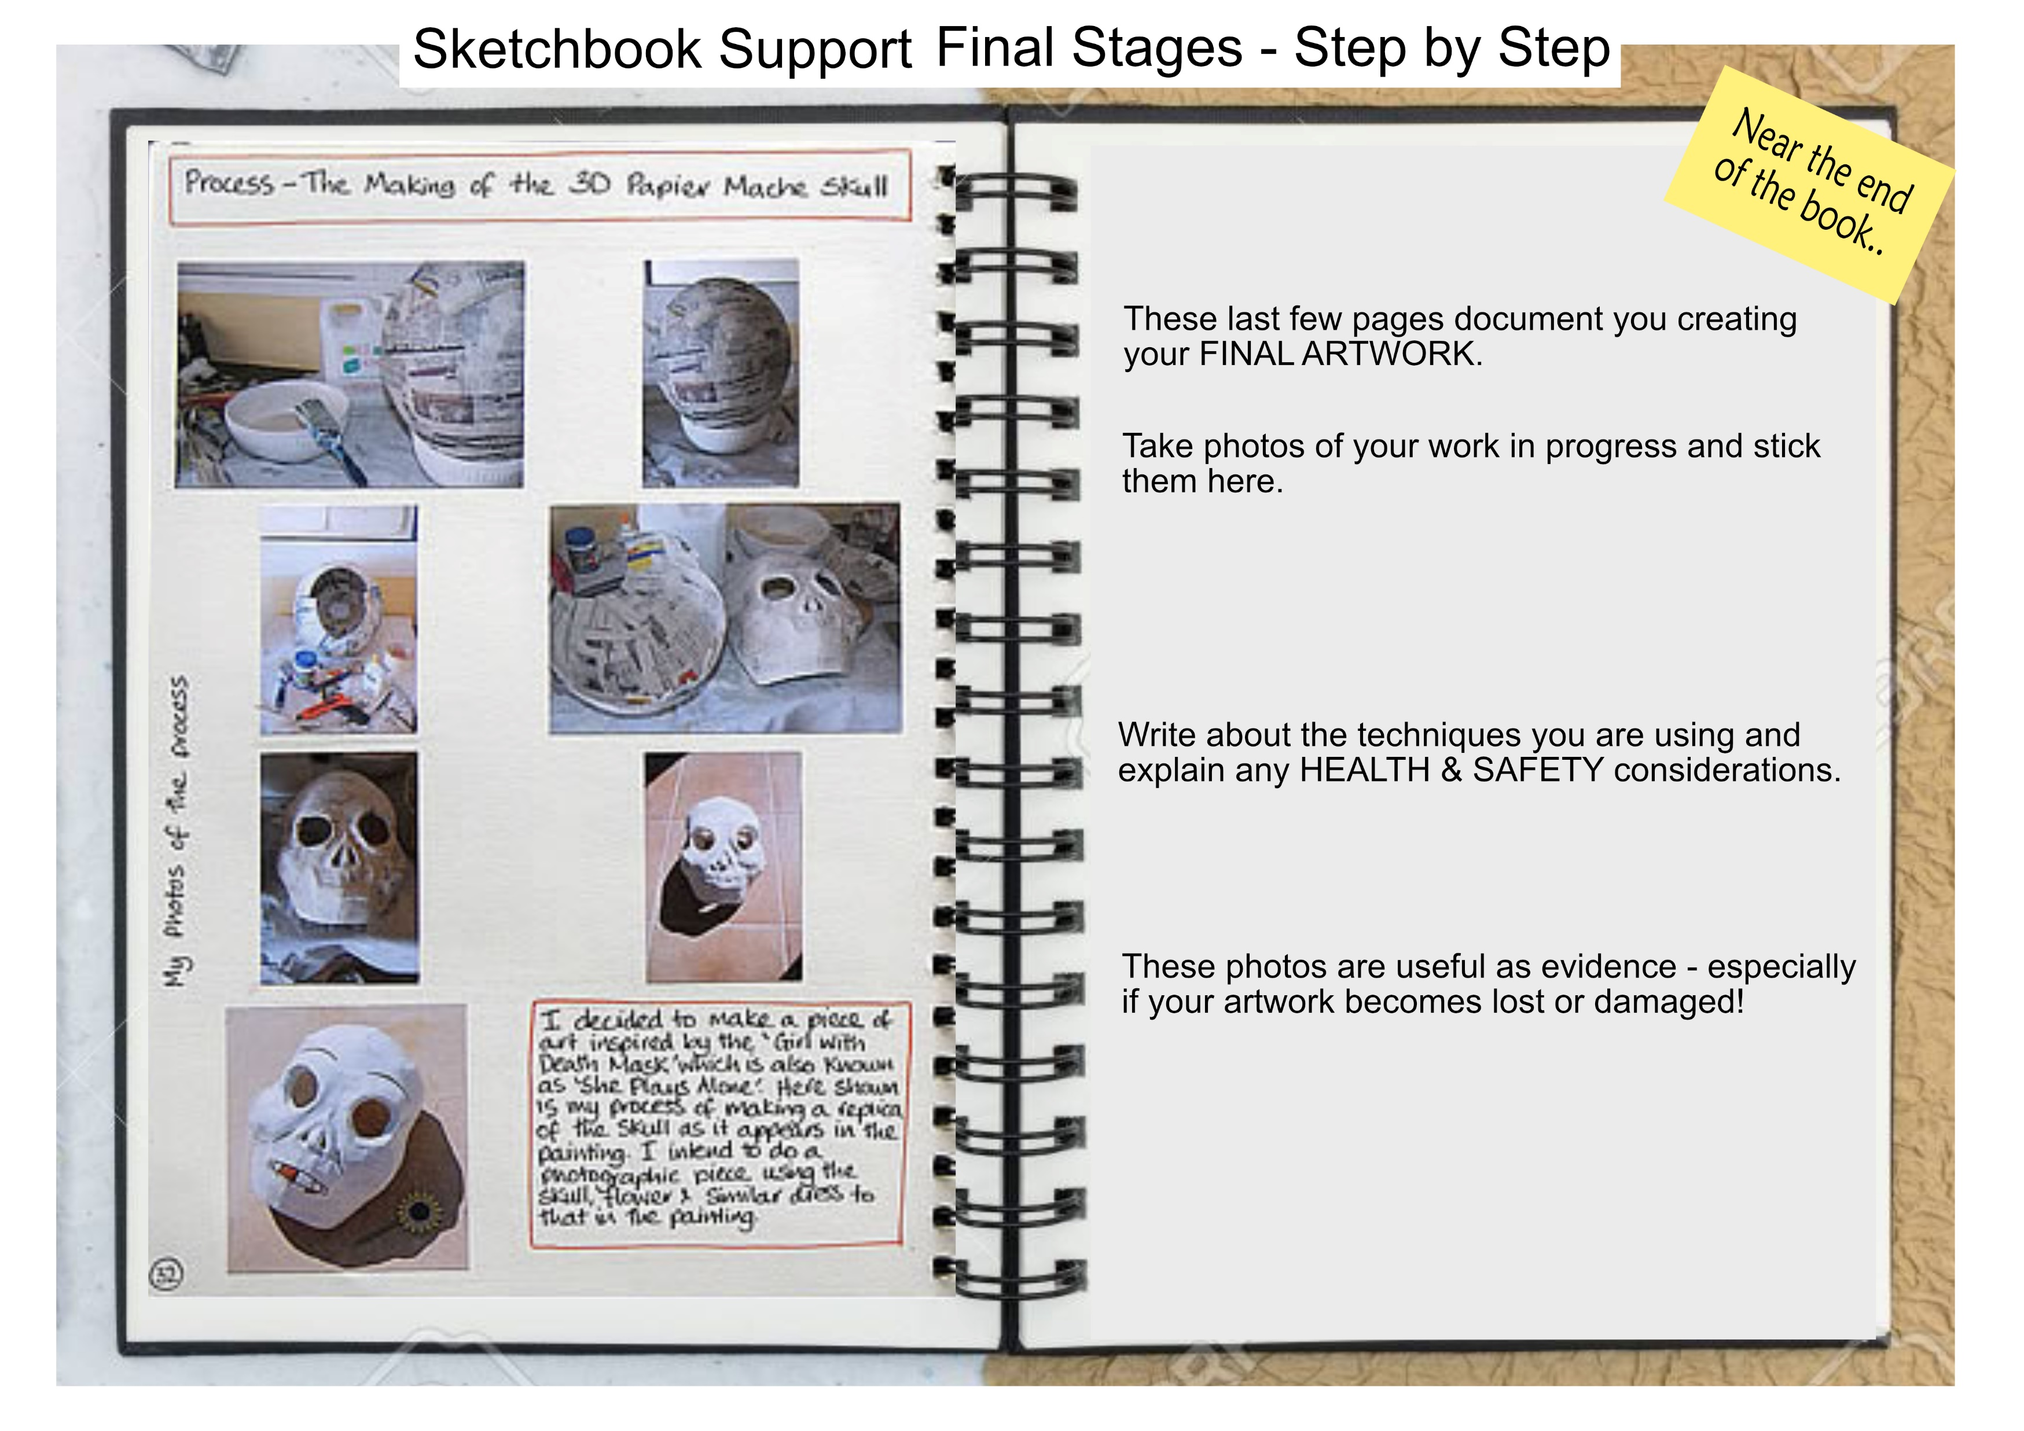

Slide 14
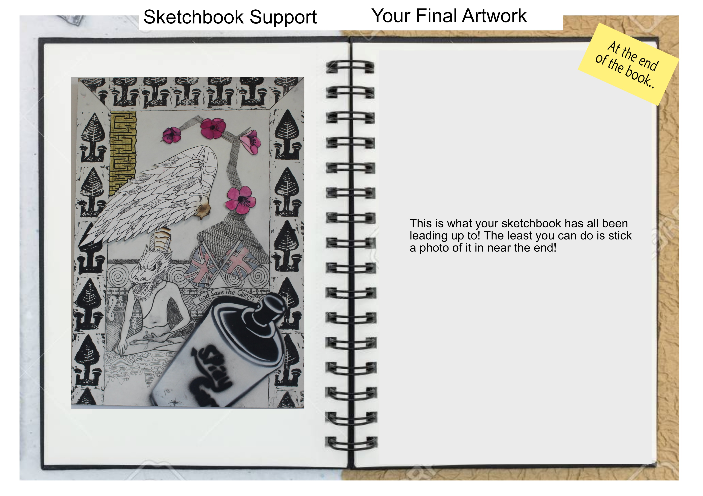

Slide 15
