Slide 1
London Cab
A new TV campaign for Tentlee tea
Notes:
Begin London sounds

Slide 2
Brief
To create a tv advert of 30 -45 seconds to promote the new ‘English Tea’ product by Tentlee.
Target audience will be adults of 25 and over as they are main consumers of this product.
Notes:
Introduce speaker and short description of Brief

Slide 3
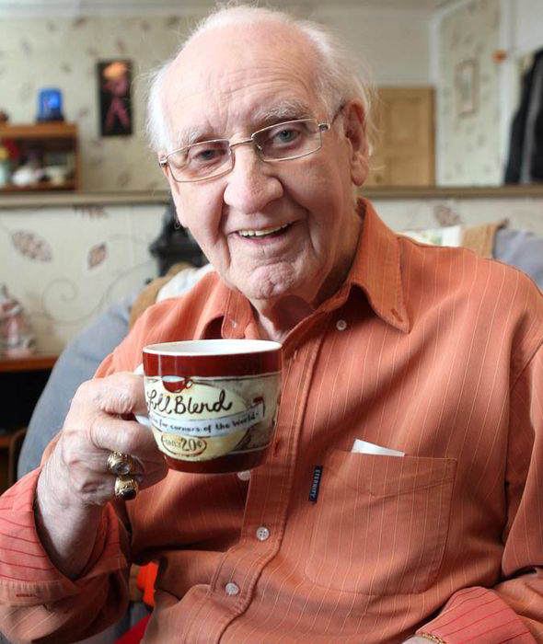
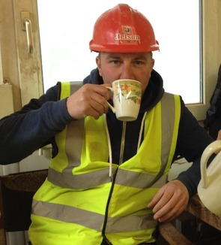
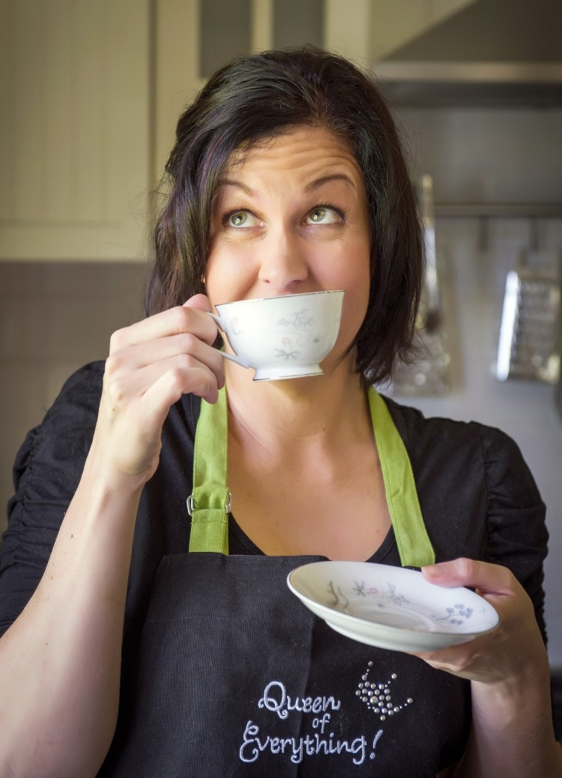
Our audience
A large demographic of mainly adults, both working and middle class, both sexes and from student to retired pensioners. Customers who enjoy good quality, no-nonsense British tea.

Slide 4
Initial Ideas
Comedy –make advert memorable
British identity
Appeal to overseas customers
British tea
Set in London
Whistling
Catchy theme tune
Stars – famous British faces,
Saturday tv or soap stars
Memorable slogan
Notes:
Use mind map by pointing to branches and describing each very briefly.

Slide 5
Plot synopsis
A typical busy street in London. A businessman gets into a black cab.
We can clearly see the businessman is overworked, tired and stressed
The cab driver turns round and we recognise him as a popular actor.
He sees the man needs cheering up and hands over a mug of tea.
The businessman takes a sip and waves of calmness and relief wash over his face. Straightaway he smiles, hands the cabbie a tip and takes of his tie.
Before the cab drives off, he gets out, drops his briefcase to the kerb and skips off happily down the pavement.
The advert ends by playing the jingle and showing the Tentlee logo.

Slide 6


Our brand

Slide 7
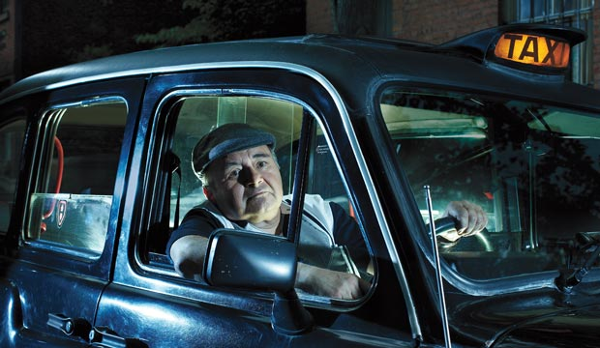
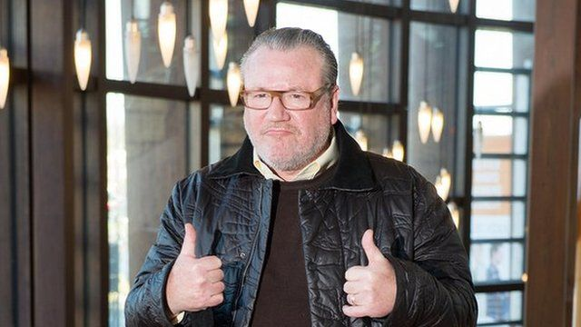
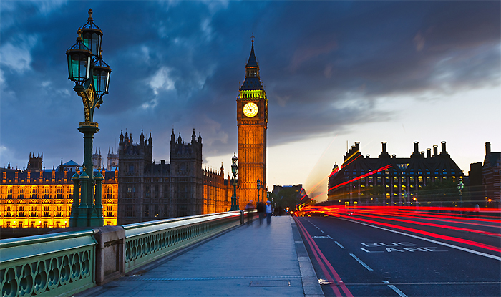
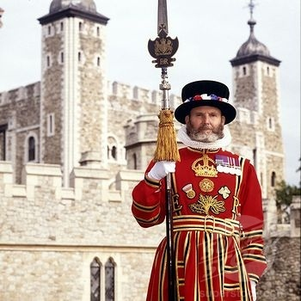
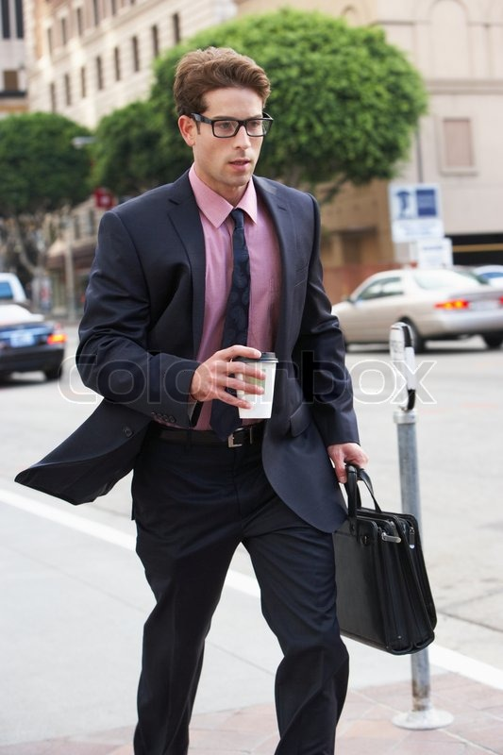
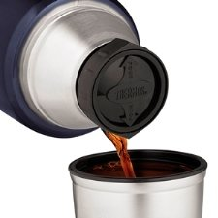
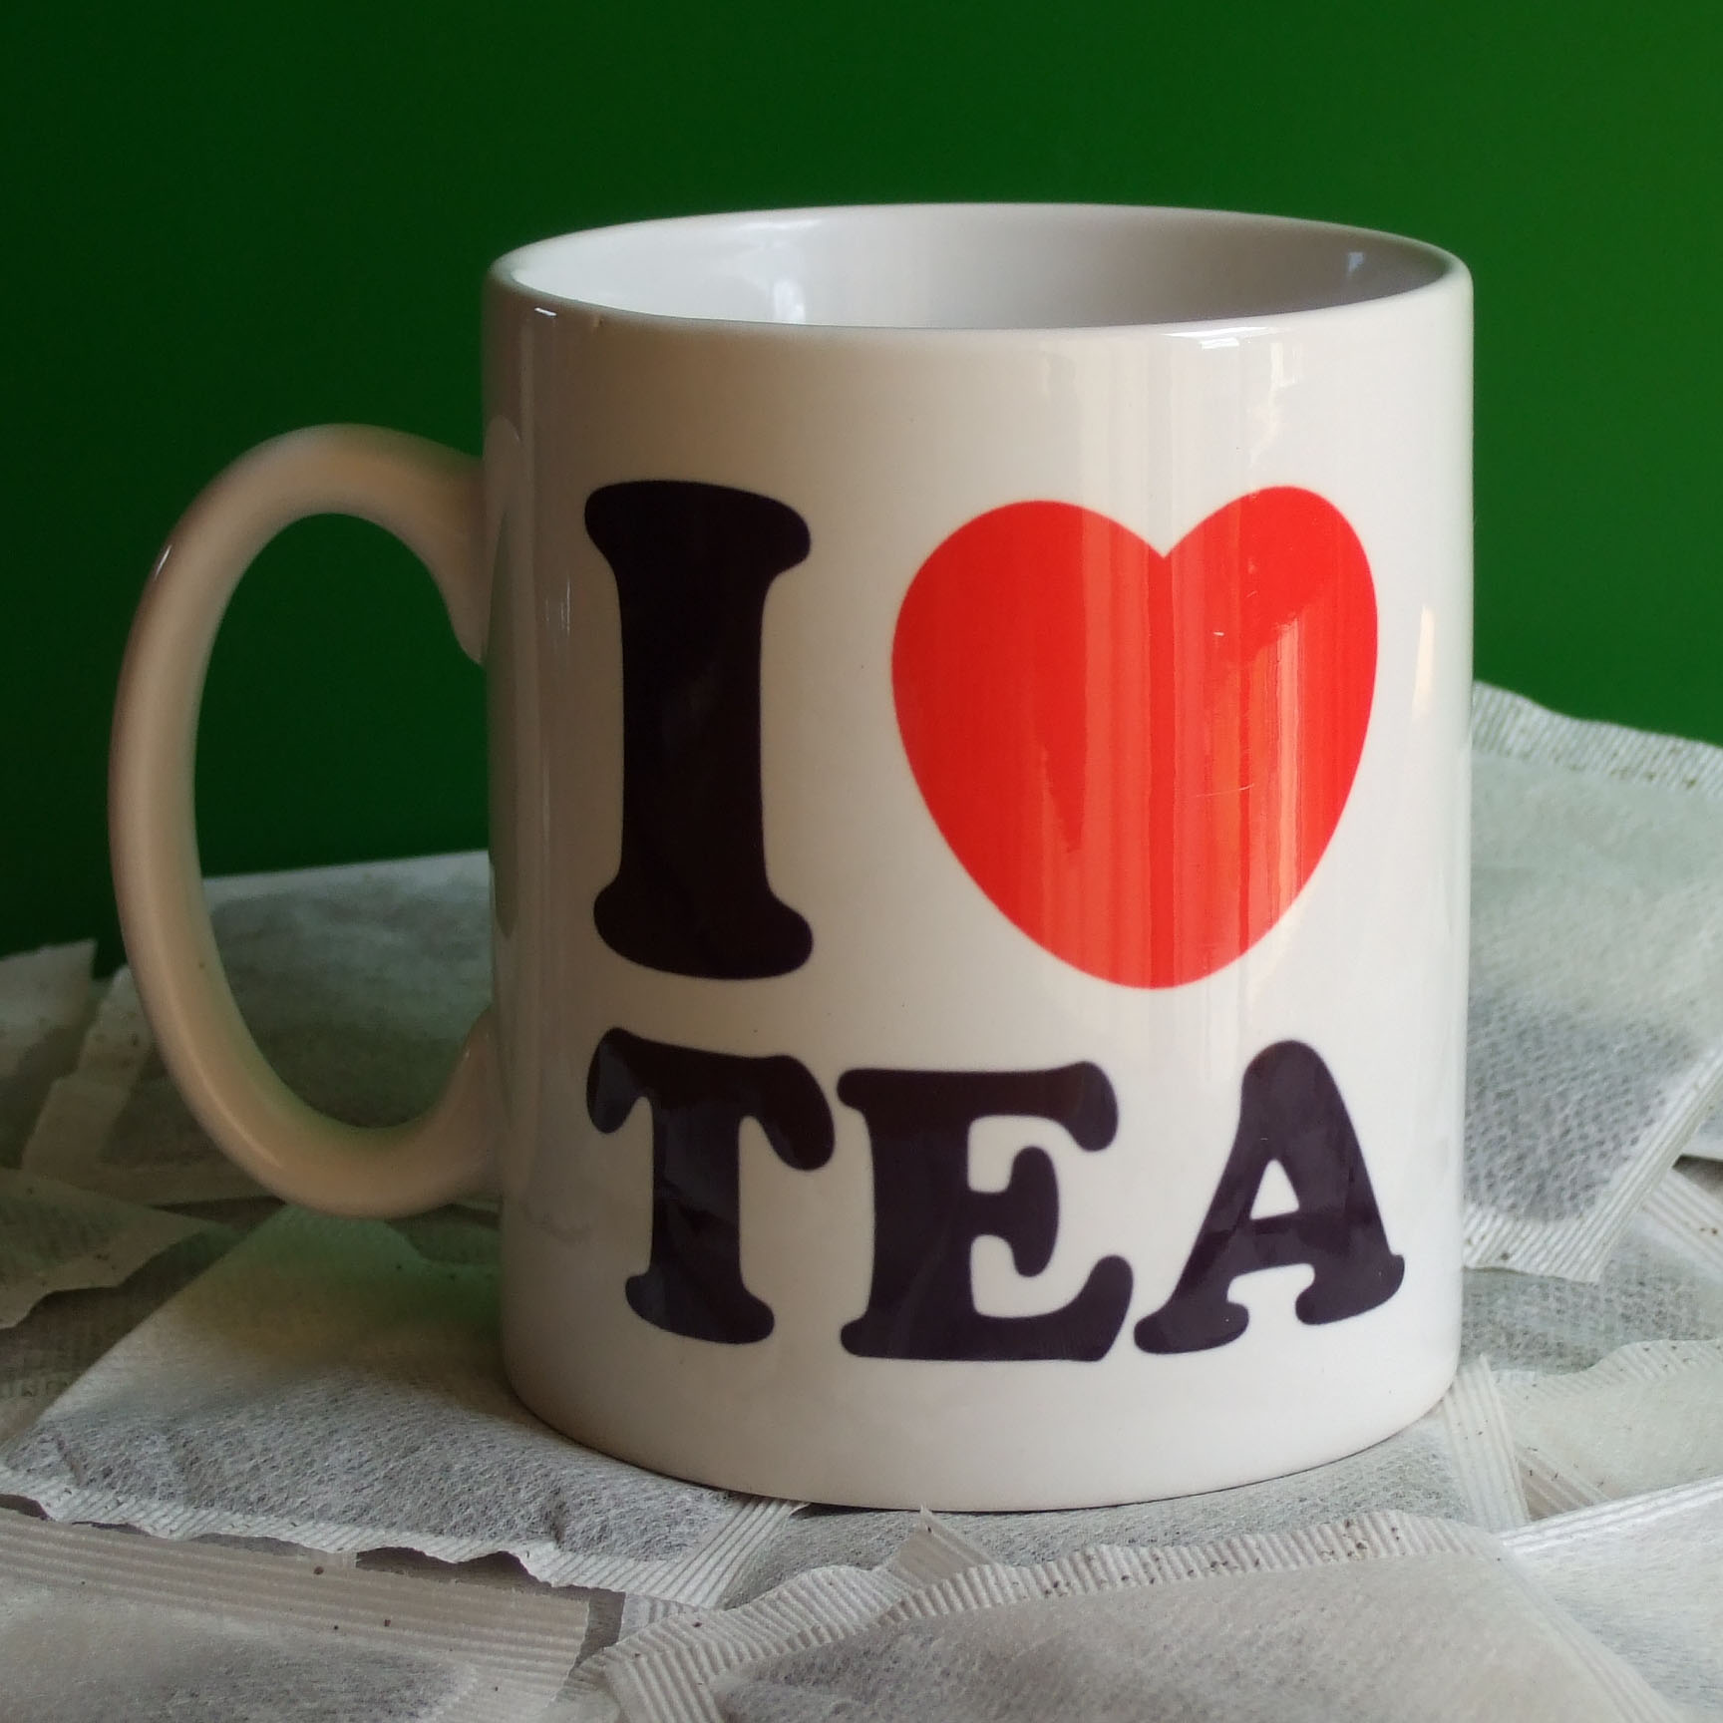
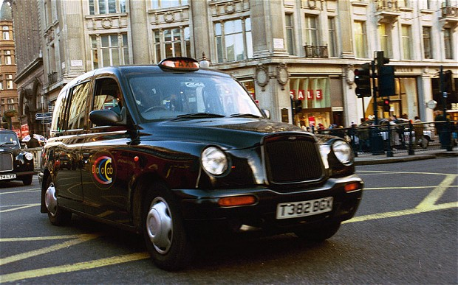
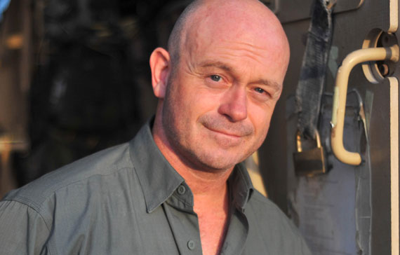
Moodboard
Notes:
Talk about London images and choice of stars

Slide 8
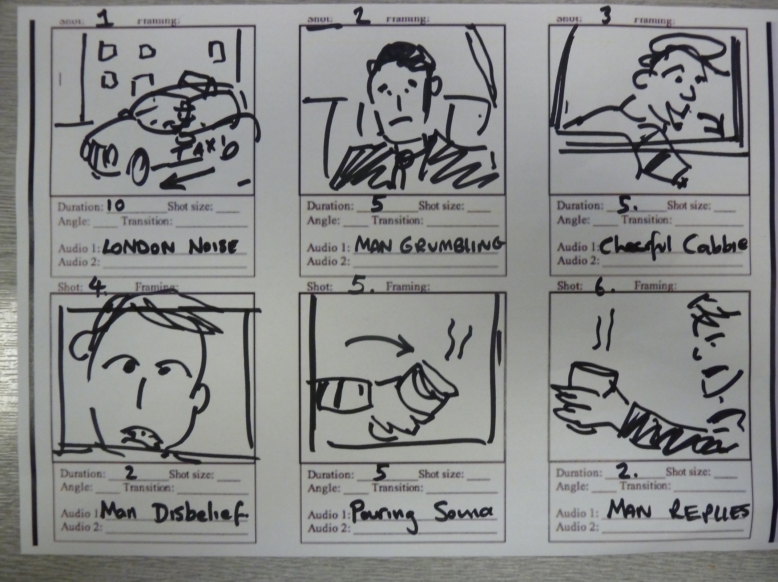
Storyboard

Slide 9
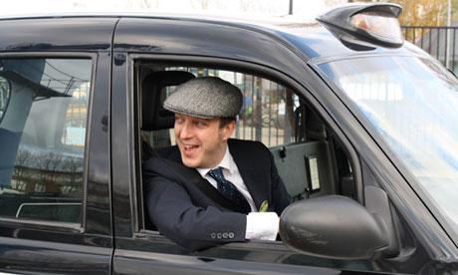

Our Star – ‘The Cabbie’

Slide 10
SWOT Analysis
Strengths Popular and recognisable location Real location – easy access for filming Memorable character – ‘The Cabbie’ Catchy theme tune | Weaknesses Cost of star like Ross Kemp May not appeal to non-Londoners / city dwellers Hot drink shown in car.
Opportunities Would also appeal to overseas customers Could create an ongoing ‘Character’ | Threats Lots of tea related characters already May become ‘stereotypical’

Slide 11
Our theme
‘The happy Cabbie’
This Royalty free soundtrack is upbeat & cheerful and was chosen to reflect the likeable personality of the cabbie.

Slide 12
Requirements of production
Filming on location in recognisable London street
Recognisable British actor
Small film crew
Daytime shoot – all day
Memorable and ‘catchy’ theme tune.
On screen brand logo and slogan text

Slide 13
Budget
COSTS
Cost of star | £10,000
Hire of filming equipment | £3500
Hire of props and vehicle | £2500
Cost of crew | £50,000
Cost of film location | £850
Cost of post production | £25,000
Total Budget - £91850

Slide 14
Key strengths
Immediately & easily identifiable by key audience of Tentlee Tea customers
Relatively small on location filming – no expensive visual effects required.
Humorous, upbeat & positive tone – popular genre for this type of tv advertising.
Opportunity to create an ongoing brand campaign with the ‘Cabbie’ character

