Slide 1
Understand the features of single camera production

Slide 2
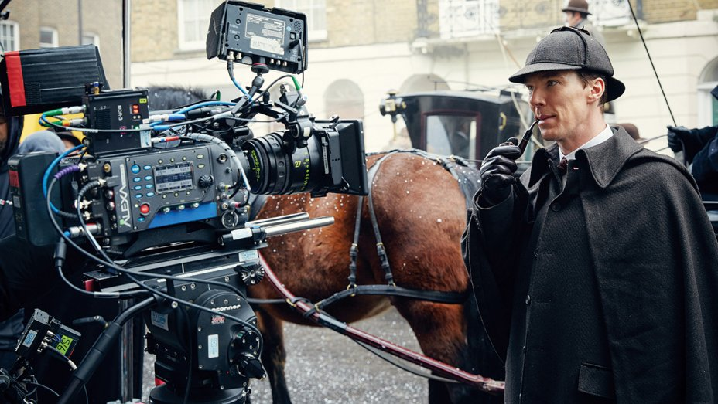
Single camera production - In this setup, each of the various shots and camera angles is taken using the same camera, which is moved and reset to get each shot or new angle. If a scene cuts back and forth between actor A and actor B, the director will first point the camera towards A and run part or all of the scene from this angle, then move the camera to point at B, relight, and then run the scene through from this angle. Choices can then be made during the post production editing process for when in the scene to use each shot, and when to cut back and forth between the two (or usually more than two) angles.

Slide 3
We will look at 4 key areas of single camera techniques:
Format
Genre
Narrative Structure
Technical construction

Slide 4
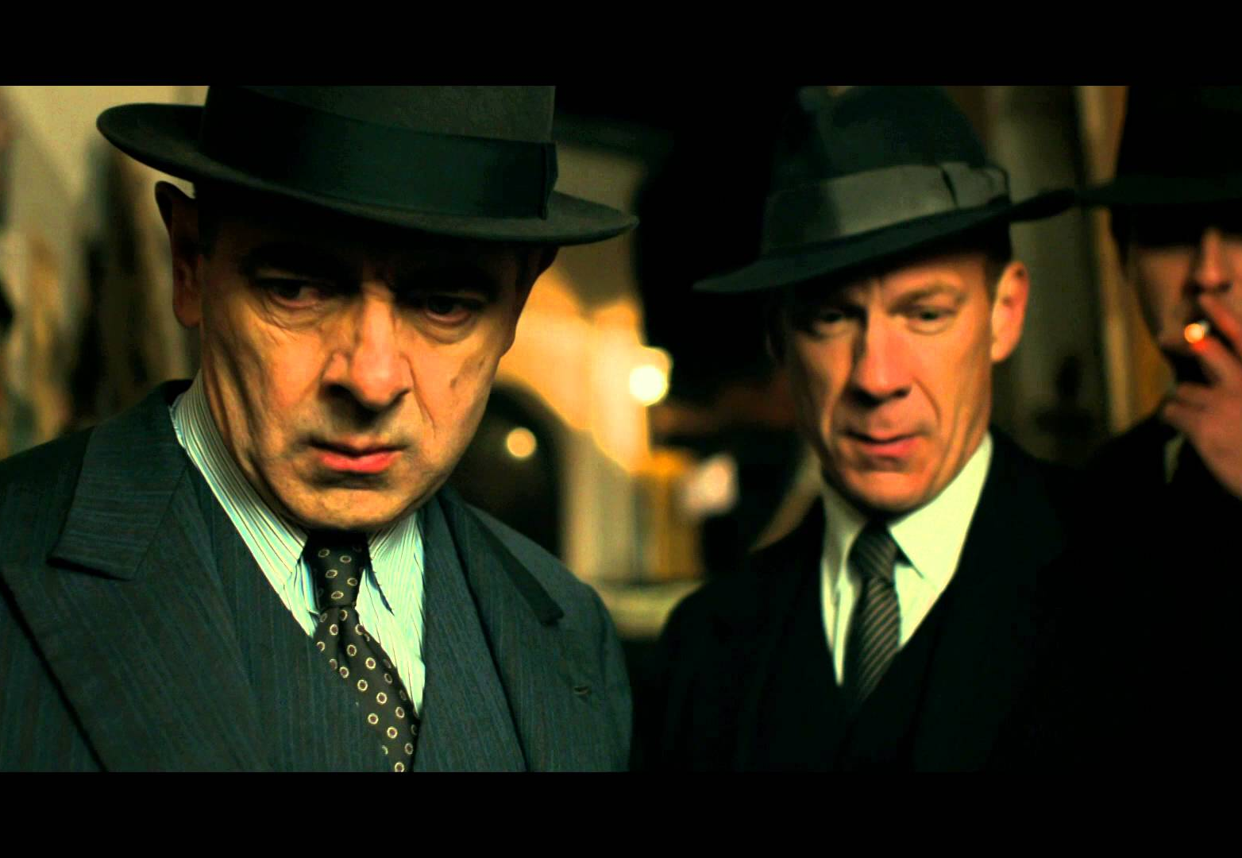
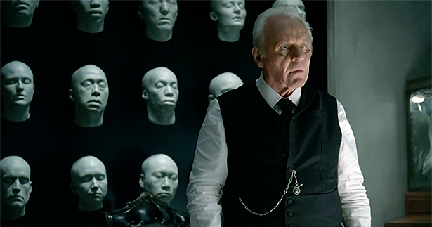

Format
Single Drama Serial Series
A Single drama is a one-off programme, and can be feature length, with a large budget
A Serial is a long story with continuing plot lines, events and characters that can last several or many seasons. Each episode usually links clearly to the next.
A Series is a formulaic sequence of stories that can be self-contained, whilst still sharing continuing characters. This is a good format for 30 minute long tv shows.

Slide 5
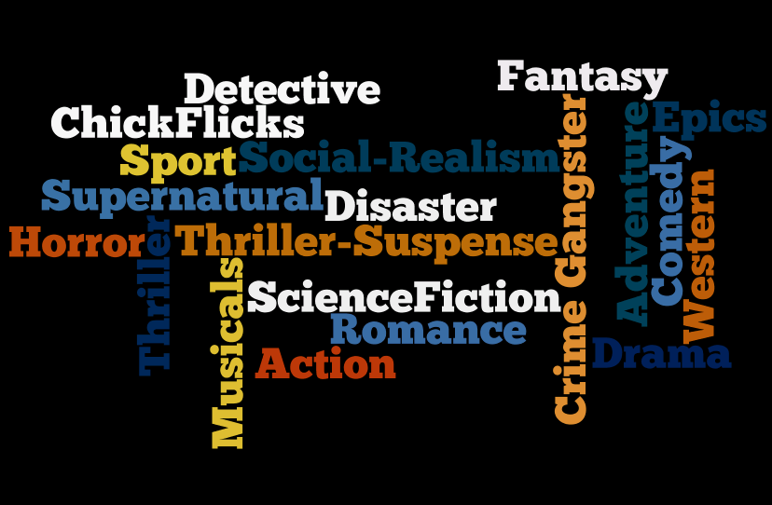
Genre
A TV or film genre is a motion picture category based on similarities in either the narrative elements or the emotional response to the film
Examples can also be classified by the setting, theme, topic, mood, format, target audience or budget

Slide 6
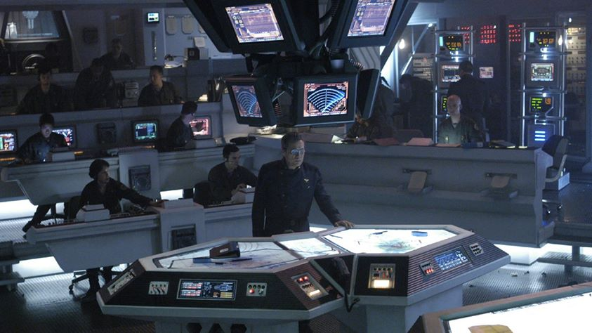
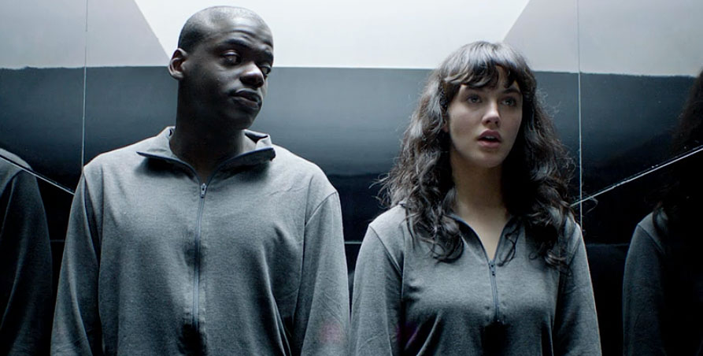
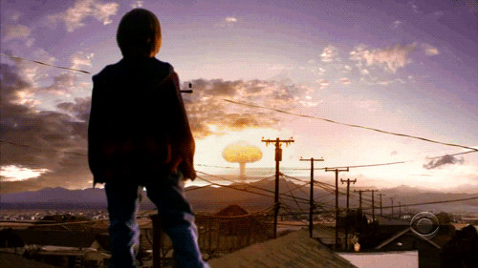
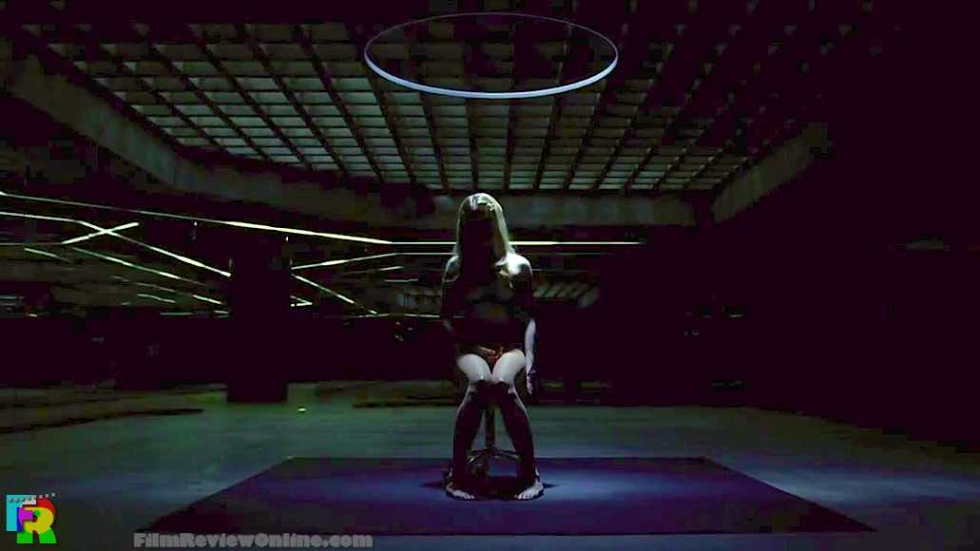
Genre can be defined by a combination of many several components including:
Setting
Narrative
Emotional response
Tone

Slide 7
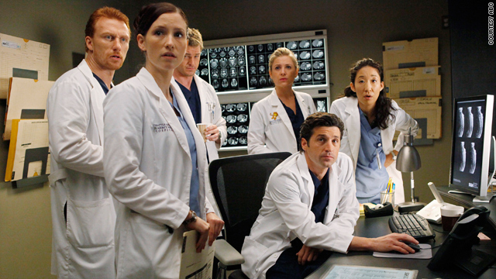

Genre can be constructed using stylistic codes

Slide 8
Narrative Structure
- Linear (or sequential)
- Non-linear (or non-sequential)
- Circular
- Flashback

Slide 9
Narrative structures
Linear Narrative
Non-Linear Narrative
Linear narratives follow a straight line — starting at the beginning, moving to the middle and proceeding to the end of the story. Often Chronological.
non-linear narrative often starts at the middle of a story or the height of a conflict and then double-backs to the beginning.
Another, albeit more challenging, non-linear narrative form employs flashbacks and “flashforwards” to keep the audience on their toes as the film tells the full story.
Flashback
Circular Narrative
A story that ends in the same place it began is commonly called a circular or cyclical narrative.
9

Slide 10
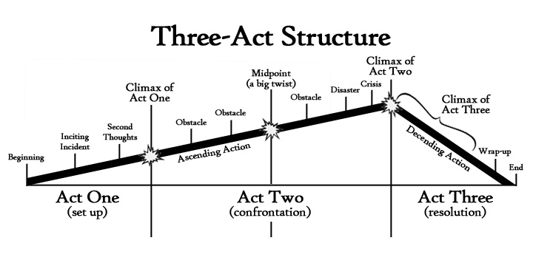
Narrative Structure

Slide 11
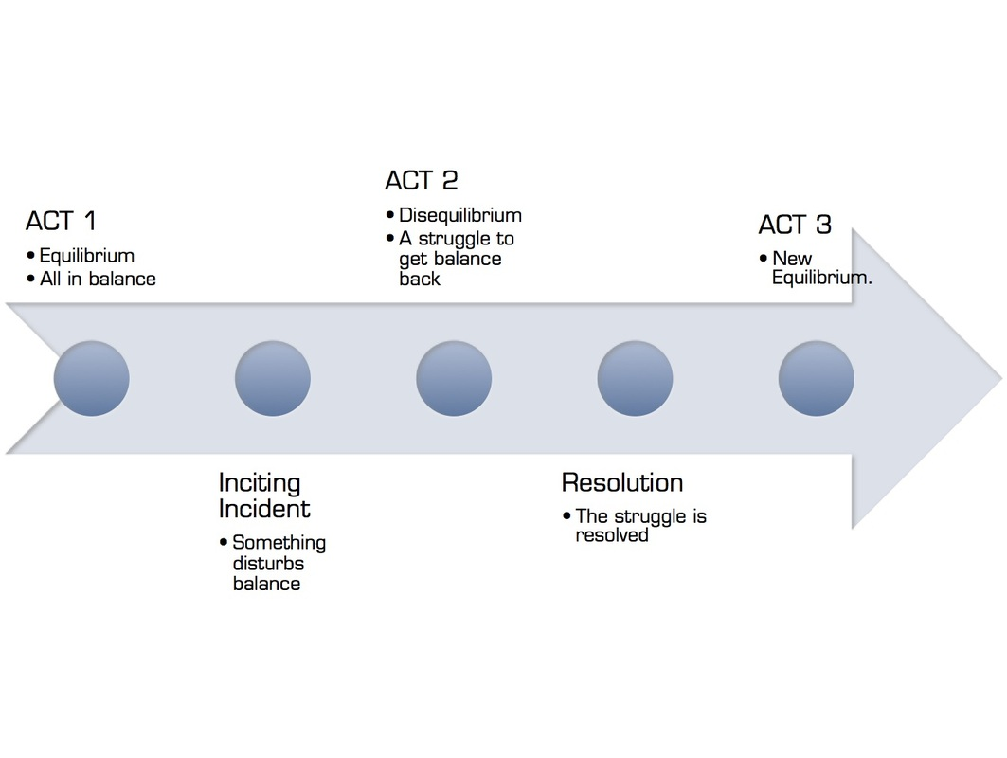

Todorov's narrative theory
Tzvetan Todorov's narrative theory suggests that all narratives follow a three part structure where they begin with equilibrium, where everything is balanced, progress as something comes along to disrupt that equilibrium, and finally reach a resolution, when equilibrium is restored

Slide 12
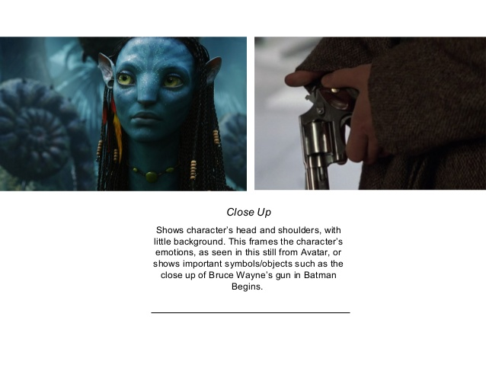
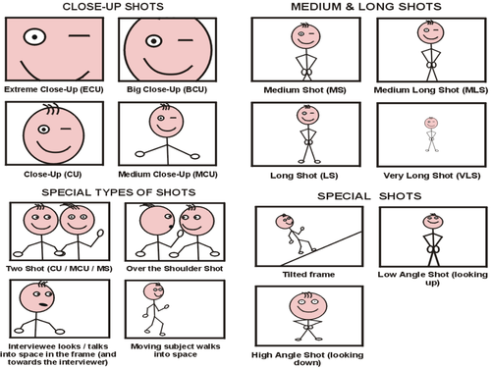
Technical construction- Camera angles
A visual language used to move the narrative forward

Slide 13
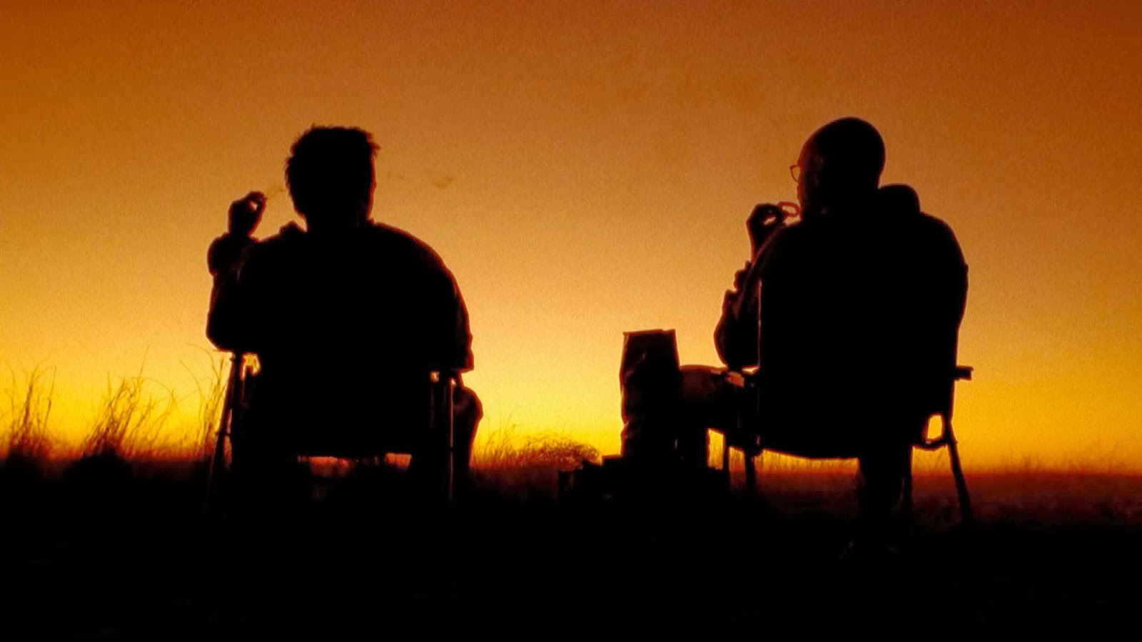
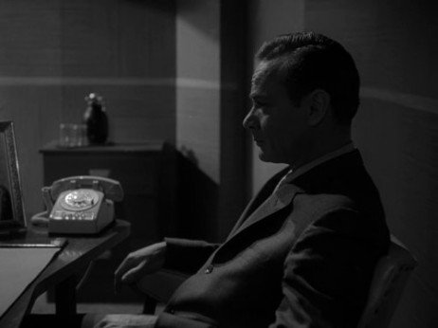
Technical construction- Lighting
Using light, or the absence of it to set the scene and tell the story

Slide 14
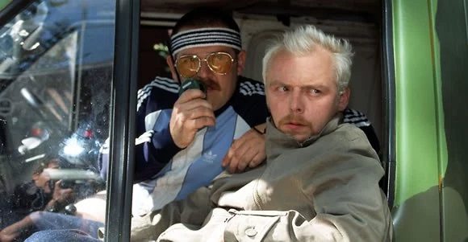
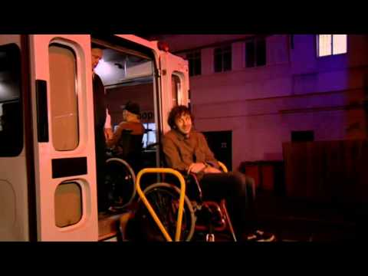
Technical construction- Editing
“No matter what genre they’re working in, an editor’s job is undoubtedly a difficult one. That said, editing comedy comes with its own set of principles and challenges that can often make it that much harder to tackle. Unlike many other genres that have a lot of leeway in terms of pacing and timing, comedic edits need to be extremely tight and specific in order to land well with an audience.”

Slide 15
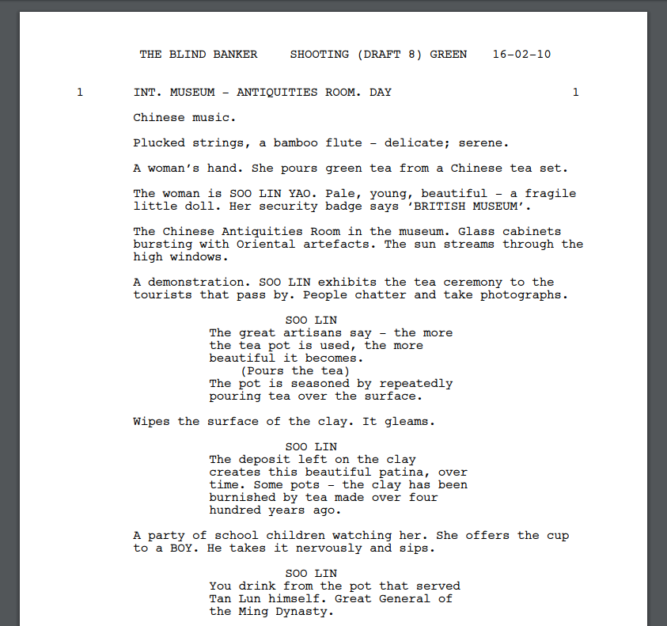
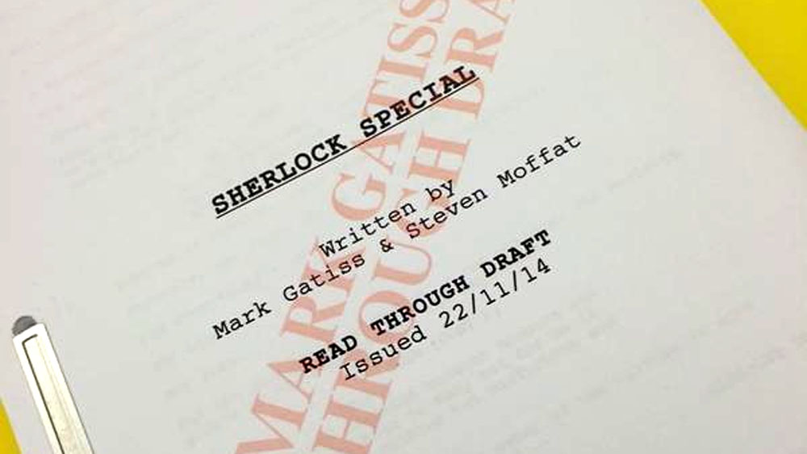
Technical construction- Scripting
How does the media producer interpret what is written on the page and translate it into digital moving video images?

Slide 16
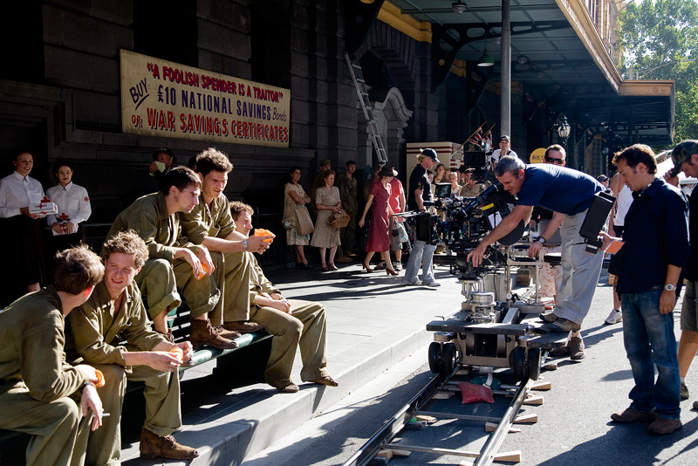
Technical construction- building a scene
A combination of set, props, lighting, location – ‘mise en scene’ all brought together to convey the media producers message

Slide 17
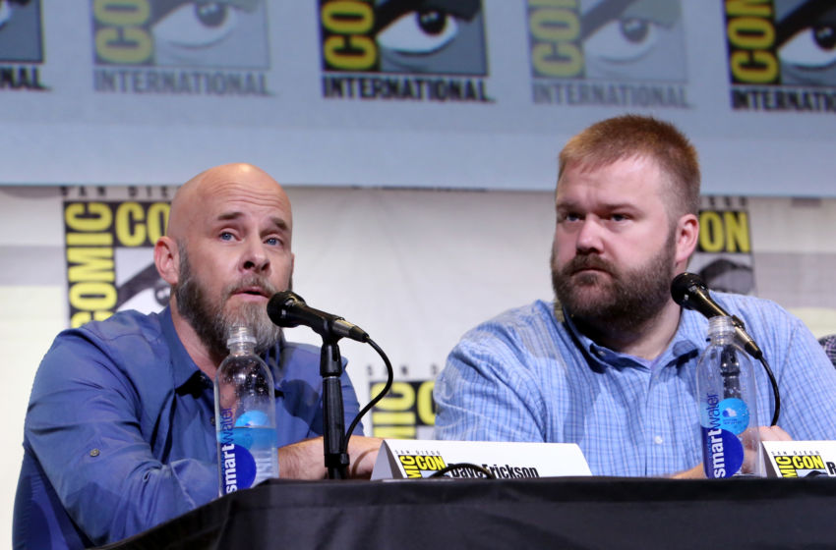
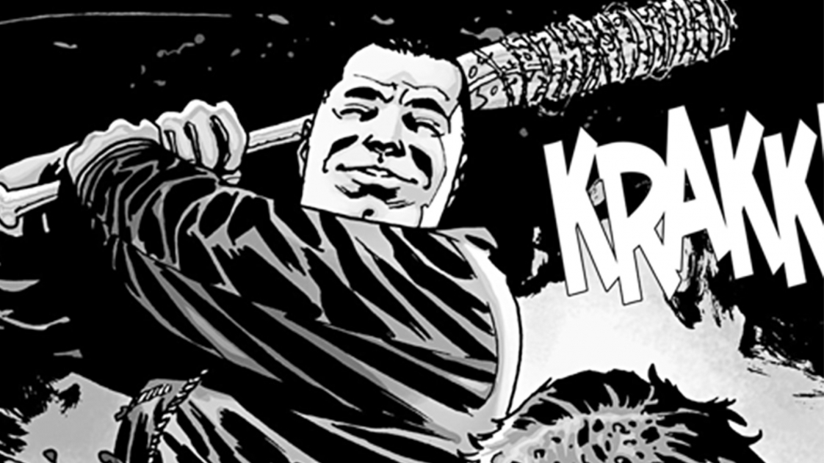
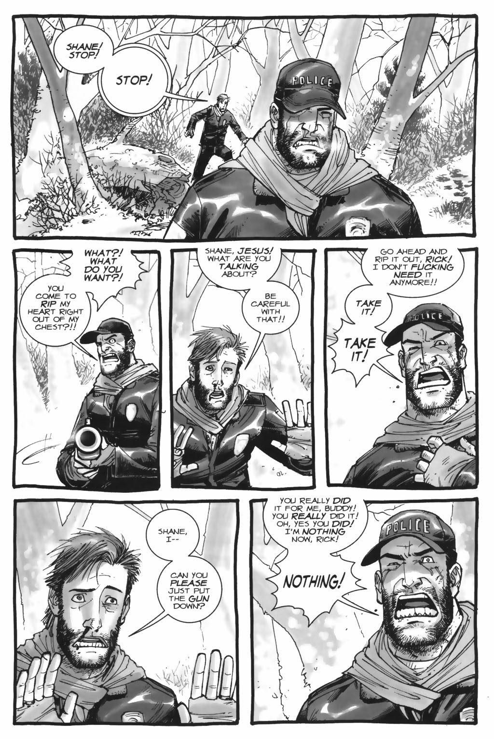
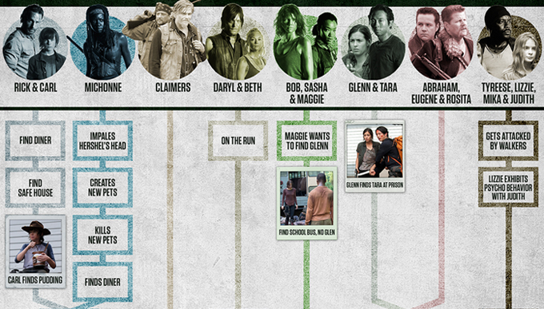
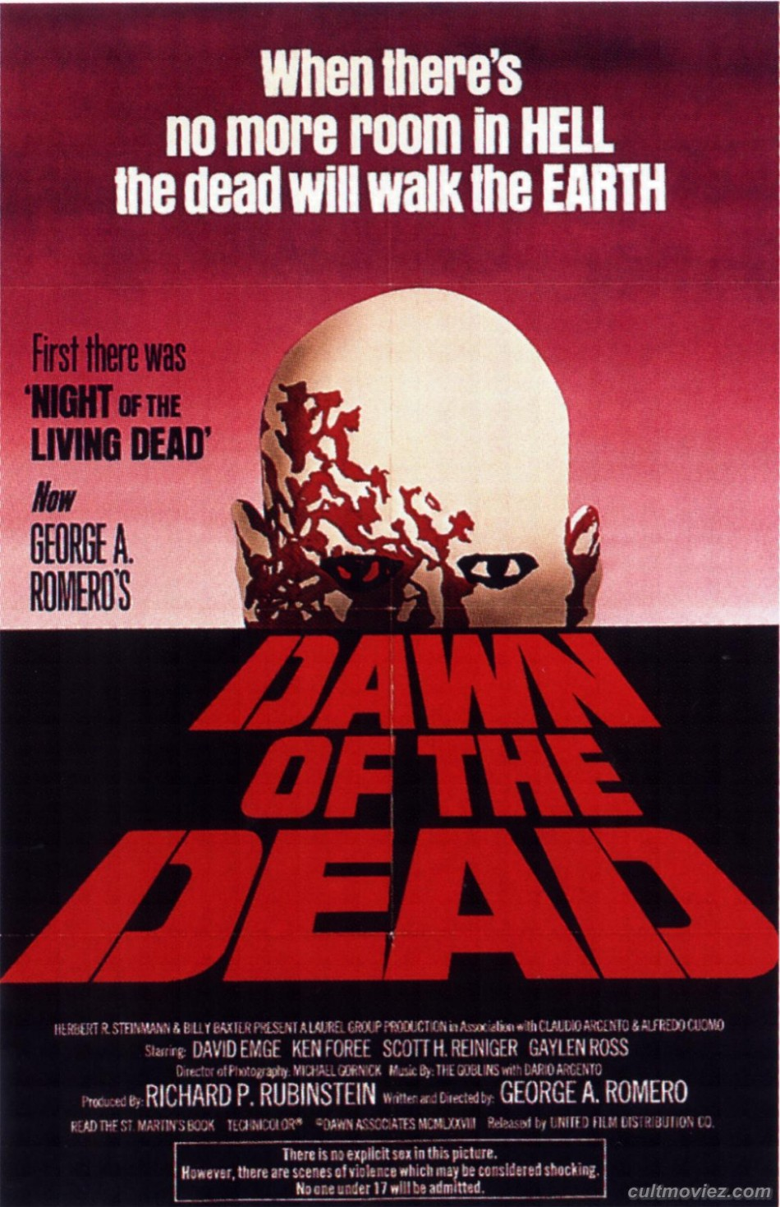
Technical construction- building a story
What influences or shapes the story writing process?

