Slide 1
Media Homework
Creative iMedia

Slide 2

Mood Boards
Fashion
Interior Design
Architecture
Ideas and concepts for a new creative media product development
Generating ideas / moods / atmospheres
Colours
Photos
Images
Fabrics
Textures
Activities
Choose from the following:
Create an A4 mini-mood-board based on :
A Romantic comedy genre – 45 mins
A horror genre – 45 mins
Research and annotate any 5 mood-boards from the internet suitable for a graphics project – 60 mins
Design and make a digital mood-board using power –point, about a superhero character – 45 mins

Slide 3
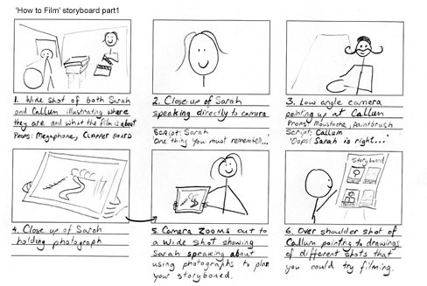
Storyboards
Film & Television
Theatre
Animation & Video
Scene sketches (content)
Timings / durations
camera shots (close up, mid, long)
camera angles
(over the shoulder, low/high angle)
camera movement (pan, tilt, zoom)
Lighting / sound / locations
Activities
Choose from the following:
Research and annotate any 5 storyboards from the internet made for animations– 60 mins
Create an A4 story-board based on :
- An action chase sequence– 75 mins
Write an A4 revision guide on storyboards explaining storyboard keywords – 45 mins

Slide 4
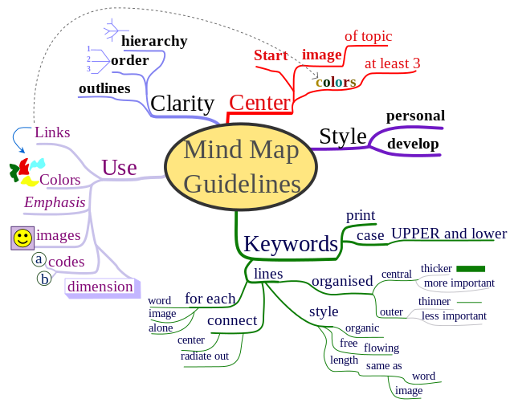
Mindmaps
Activities
Choose from the following:
Mind map in detail all the different types, keywords and uses of pre-production documents – 45 mins
Pick a magazine advert and mind map all of its features and themes – 60 mins
Create a table that lists a range of media job roles, and how they would each use mind maps for a different purpose – 35 mins
Show development routes
Options for or parts of an idea
Resources needed for a creative media
product
Workflow diagram
Central idea
Branches
Keywords
Colour
Icons
Topics

Slide 5
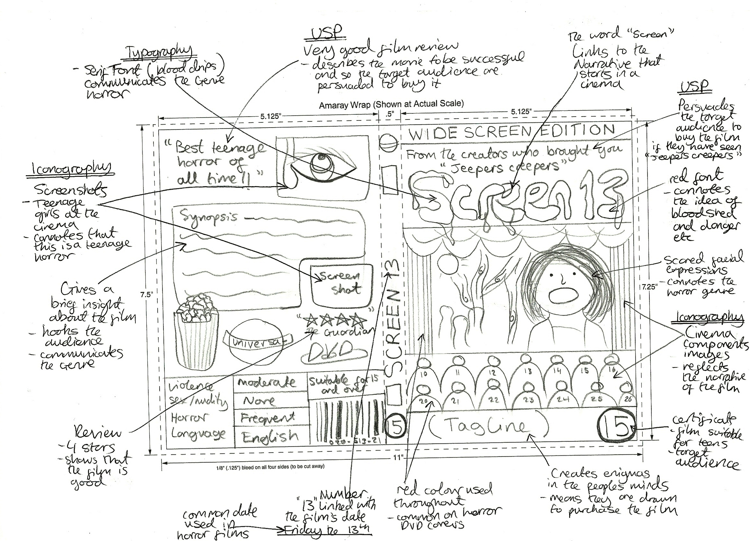
Visualisations
Activities
Choose from the following:
Sketch out a visualization for a film poster based on your idea for a superhero film – 85 mins
Research and annotate any 5 visualisations from the internet suitable for a video game project– 60 mins
Sketch out the layout for a website home page. The website is called ‘Healthy hotels.com’ – 60 mins
Design layouts
Rough sketches
Character and costume ideas
Still Images & graphics
Posters / CD & DVD covers
Leaflets & Flyers
Images
Graphics
Logos
Text
Colour
Dimensions

Slide 6
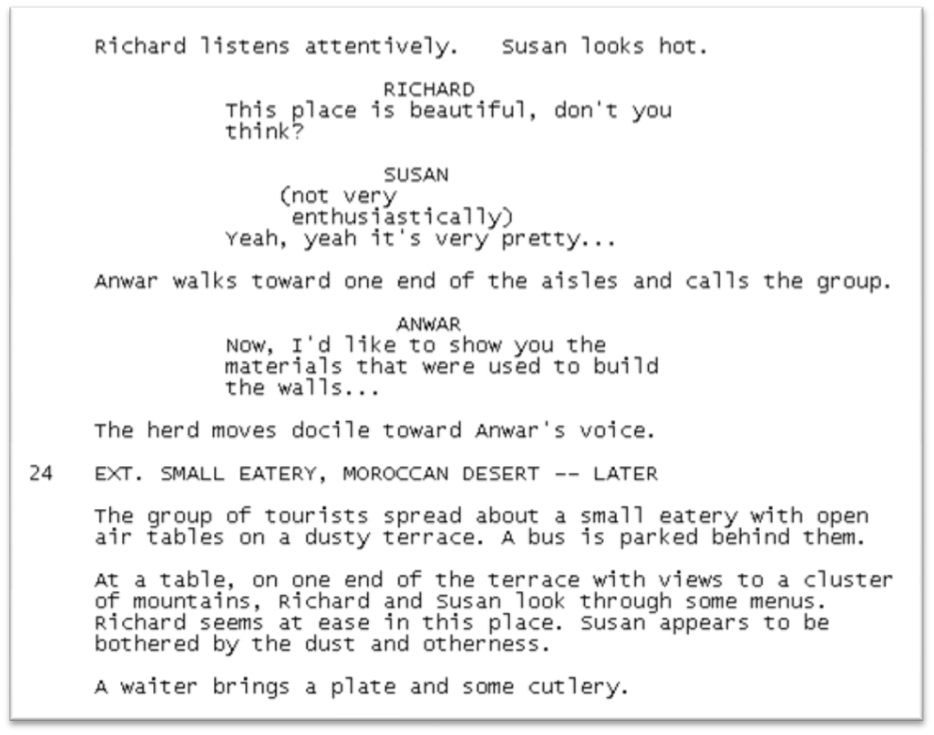
Scripts
TV & Film
Theatre, drama and plays
Voice over
Comics and computer games
Set / location
Direction (what happens in a scene)
Sounds
Dialogue and conversation
Mood, emotion
Activities
Choose from the following:
Write an A4 ‘Dummies-guide’ to script writing – 60 mins
Find a script on the internet – draw the storyboard for it – 90 mins
Type up a script for the beginning of a story based around a relationship break up – 60 mins

Slide 7
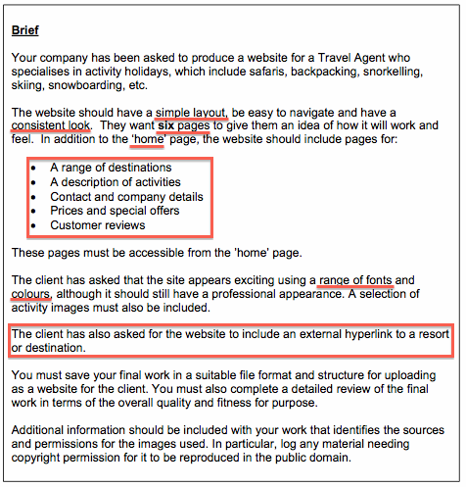
Interpreting Client Requirements based on a specific brief
What are client requirements?
The person / company you’re working for is the client
What they want
Success criteria
Expectations
Scenario (title)
Assignment / tasks – what needs to be done
What needs to be produced
What is a brief?
Written out in a description of what needs to be done
Activities
Choose from the following:
Pick a popular game on a console. Write out in detail what you imagine to have been the client requirements for it – 75 mins
Write out the client requirements for any brief from the end of this guide - 60 mins

Slide 8
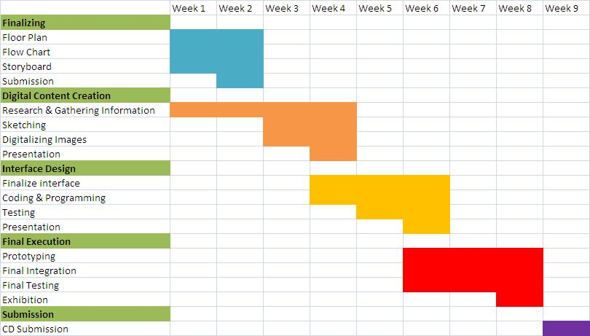
Work Plans + Production Schedules
Choose from the following:
Create a Gantt chart work plan that contains each of the keywords (left) for a project about large scale graphics for a sports shop window display – 90 mins
Activities
  tasks
  activities
  work flow
  timescales
  resources
  Milestones
  contingencies

Slide 9
Primary sources
Primary Sources
Directly from the source
Autobiography
Original works
1st hand account
Diary
Interview
Video footage
Photo
Relics
Official records
Activities
Choose from the following:
For each primary source listed suggest how they might be used in:
A Blockbuster film – 25 mins
A news broadcast – 25 mins
A radio play – 25 mins
Research & use examples of each

Slide 10

Secondary sources
Activities
Choose from the following:
List secondary sources suitable for use on a media project. Give examples for each one – 45 mins
Locate a secondary source of information that could be used for a charity tv advert. Discuss how/why it could be relevant, biased and reliable – 25 mins

Slide 11
Types of Software/
Names of Software
Graphics Editing
Video Editing
Audio editing
Word Processing
Presentation
Spreadsheet
Database
Activities
Choose from the following:
Create a table. For each type of software on the left give a named example, its platform, tech requirements and a comment about its features – 90 mins
Pick any type of software, and write an in-depth review of a program in that group including pros & cons and a star rating – 45 mins

Slide 12
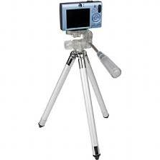
Hardware
Computer
Scanner
Printer
Graphics Tablet
Camera
Video Camera
Microphone
Pens, pencils etc
Monitor or screen
Activities
Choose from the following:
Put together a simple power-point with each slide describing the key features needed for each piece of hardware – in your own words – 45 mins
Write a checklist of hardware needed to create a 3 minute film trailer – 30 mins

Slide 13
Copyright © & Trademarks ™
Check for copyright / trademark
Contact the owner
Ask for permission to use it
Pay a fee
Activities
Choose from the following:
Write a beginners guide to copyright and the media – 2 A4 pages – 60 mins
Research an example of copyright infringement in any media sector. Write a brief article with images and your own point of view – 45 mins

Slide 14
Video File Formats
MPG
MOV
MP4
Compressed file formats
Small file sizes
Fast loading online (speed)
Choose from the following:
Create a table. For each file format list its pros & cons, and most suitable uses, and on which platforms – 25 mins
Activities

Slide 15
Animation File Formats
SWF
FLV
Compressed file formats
Small file sizes
Fast loading online (speed)
Choose from the following:
Locate & download 1 of each file type. Open them in a suitable program and comment on its properties and uses – 25 mins
Activities

Slide 16
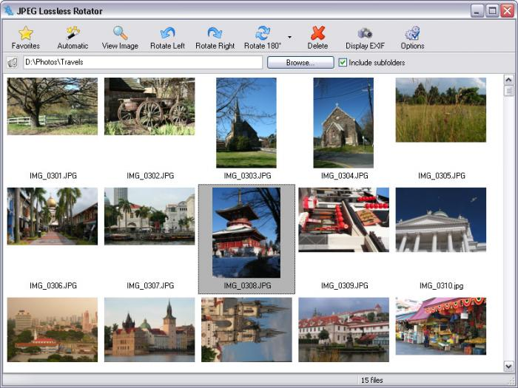
Image File Formats
JPG (lossless compression; photography)
PNG (lossless compression; photography)
TIF (large file sizes / Posters / high quality printing)
PDF (un-editable/ Documents)
GIF (small file sizes/ Online / web buttons)
Choose from the following:
Create or locate 1 of each image file type .Store them in a clearly labelled folder with aa relevant file name – 45 mins
Activities

Slide 17
Audio File Formats
MP3 (compressed / small file sizes / good for devices)
AIFF (uncompressed / high quality / Mac only)
WAV (uncompressed / high quality / Windows only)

Slide 18
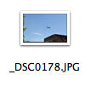
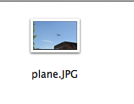
Assets & Suitable naming conventions
Activities
Choose from the following:
Sort through your media folder, and /or any other folders. Rename all files with content names, suitable dates and uses- 25 mins
Pick any media project. Create an asset table listing ALL files used in that project, where they are stored and their source – 25 mins

Slide 19


Some imedia guidelines
Creative iMedia

Slide 20
Reviewing a Preproduction Document
Compare it back to the brief / client’s requirements
Positives / advantages / benefits
Negatives / disadvantages / drawbacks
Improvements to make
Write a conclusion
Use technical language & terminology
Focus on spelling, grammar and punctuation
Neat, legible handwriting

Slide 21
Compared to the brief…
Review and compare your work to the original brief – have you done what was asked? How?
Think about the following:
format
style,
clarity
suitability of content for the client and target audience

Slide 22
Positive aspects of my work
Think about the following:
format
style,
clarity
suitability of content for the client and target audience
colour scheme
content
additional scenes

Slide 23
Negative aspects of my work
Think about the following:
format
style,
clarity
suitability of content for the client and target audience
colour scheme
content
additional scenes

Slide 24
Identify areas for improvement in a pre-production document
Think about the following:
format
style,
clarity
suitability of content for the client and target audience
colour scheme
content
additional scenes

Slide 25
Location Recces
Visit a location prior to filming
Check it’s suitable
Lighting?
Safe?
Electricity?
Scenery?

Slide 26
Risk Assessments
Identify the hazards / dangers
Decide who might be harmed and how
Evaluate the risks and decide on precautions
Record your findings and implement them
Review your assessment and update if necessary

Slide 27
Safe Working Practices in Media
Using computers:
  Chair height
  Distance from screen to eyes
  Keyboards / mice comfortable
Working at heights
Working with electricity
Working with heavy equipment

Slide 28
Sample Briefs
Lime Tree Media is a TV company specializing in daytime television entertainment shows. They need a new brand including title & logo well suited to its target audience.
A feature film needs character and costume designs for a female assassin from 19th century Japan. They must include both pencil and digital versions of the character.
A comic about the dangers of recreational drug use is being produced by the government. They require a story outline and rough draft of the characters speech.
A radio show on Capital has a section about fashion. The producer needs a new jingle between advert breaks to reflect suitable themes aimed at a teenage audience.

